Slide 1






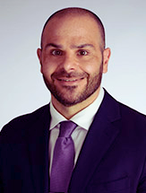





K
a
n
S
u
r
v
i
v
e
2
.
0
Testing Enhanced Models of Cancer Survivorship Care for Rural Cancer Survivors in Primary Care Practice
Lung Cancer Screening & Survivorship in Rural Primary Care
kansurvive.com
Guest Speaker:
Michal Reid, MD
Assistant Professor, Pulmonary, Critical Care & Sleep Medicine

Slide 2

K
a
n
S
u
r
v
i
v
e
AGENDA
2
.
0
Time | Presentation | Presenter
12:00 - 12:05 pm | Welcome & Introductions | Team
12:05 - 12:15 pm | Cancer Survivorship Review | Jennifer Klemp, PhD
12:15 - 12:45 pm | Didactic: Lung Cancer Screening & Survivorship | Michal Reid, MD
12:45 - 12:55 pm | Case Presentation & Discussion | Dr. Reid & Team
12:55 - 1:00 pm | Wrap-up & Announcements | Team
kansurvive.com

Slide 3


K
a
n
S
u
r
v
i
v
e
RECORDING & TIPS
2
.
0
  Mute yourself when not speaking.​
  Turn your camera on – we would love to see you!​
  Speak up, use the chat box, and actively engage.​
  Visit www.kansurvive.com for session materials.
kansurvive.com
By participating in this ECHO clinic, you are consenting to be recorded.
Recording is for educational and quality improvement purposes.​

Slide 4


K
a
n
S
u
r
v
i
v
e
CONTINUING EDUCATION CREDIT
2
.
0
In support of improving patient care, University of Kansas Medical Center is jointly accredited by the Accreditation Council for Continuing Medical Education (ACCME), the Accreditation Council for Pharmacy Education (ACPE), and the American Nurses Credentialing Center (ANCC), to provide continuing education for the healthcare team.​
Physician: ​
The University of Kansas Medical Center designates this live activity for a maximum of 1 AMA PRA Category 1 Credit™. Physiciansshould claim only the credit commensurate with the extent of their participation in the activity.​
​
Nursing: ​
The University of Kansas Medical Center designates this activity for a maximum of 1 ANCC contact hours. Nurses should claim onlythe credit commensurate with the extent of their participation in the activity.​
​
Certificate of Attendance:​
Certificates of attendance are available to other participants upon completion of documentation of attendance and evaluation asoutlined​
​
Attendance requirement : ​
Participants missing more than 10% of this offering will not receive continuing education credit.​
kansurvive.com

Slide 5
K
a
n
S
u
r
v
i
v
e
DISCLOSURES
2
.
0
kansurvive.com

Slide 6
K
a
n
S
u
r
v
i
v
e
COMMERCIAL / NON-COMMERICAL SUPPORT
2
.
0
There is no commercial support for this CE activity. ​
kansurvive.com

Slide 7
K
a
n
S
u
r
v
i
v
e
FUNDING SOURCE
2
.
0
This project is funded by the National Cancer Institute (U01CA290664-01) with additional support from the University of Kansas Cancer Center (KUCC), Masonic Cancer Alliance (MCA), Kansas Patients and Providers Engaged in Prevention Research (KPPEPR), and Frontiers CTSA .
kansurvive.com

Slide 8


K
a
n
S
u
r
v
i
v
e
Announcements
2
.
0
How (else) can KanSurvive 2.0 add value to your practice?
  Cost analysis opportunity for AI / scribe services
  EHR workflow support (e.g., build templates, AI training)
  Identify referral resources for specialties (e.g., pulmonary rehab)
  Training & resources for staff
Questions? We can help!
Catie
cknight2@kumc.edu
Araceli
amaldonado2@kumc.edu

Slide 9

K
a
n
S
u
r
v
i
v
e
Learning Objectives
2
.
0
Learning Objectives
By the end of this session, participants will be able to:
  Describe the core components of lung cancer screening and survivorship care
  Recognize common long-term and late effects of lung cancer treatment
  Recognize challenges in assessing eligibility, access, and adherence to lung cancer screening
  Apply lung cancer survivorship care and screening guidelines to routine primary care
  Use tools and documentation strategies to support lung cancer screening and lung cancer survivors

Slide 10

K
a
n
S
u
r
v
i
v
e
Introduction
2
.
0
LC Survivorship: A Changing Landscape
  LC survival rates are improving due to advances in screening, early detection, and targeted/immunotherapies.
    In the U.S., the number of LC survivors rose from ~571,000 (2019) → 655,000 (2022) and is projected to reach >870,000 by 2035.
  Reminder: Survivorship begins at diagnosis and spans curative and non-curative trajectories
  Median age at LC diagnosis ≈ 71 years; 40–60% have COPD/emphysema, CVD, or musculoskeletal comorbidities
  Implication for primary care: increasing numbers of older, multimorbid survivors needing longitudinal symptom and functional management.
Ha DM, Jacob RA, Bade BC. Survivorship Challenges and Supportive Care in Lung Cancer. Semin Respir Crit Care Med. 2025 Jul 30:10.1055/a-2649-9311. doi: 10.1055/a-2649-9311. Epub ahead of print. PMID: 40623689; PMCID: PMC12369273.

Slide 11
K
a
n
S
u
r
v
i
v
e
2
.
0
Introduction
Our guest speaker today...
Lung Cancer Screening & Survivorship in Rural Primary Care
Guest Speaker:
Michal Reid, MD
Assistant Professor, Pulmonary, Critical Care & Sleep Medicine

Slide 12
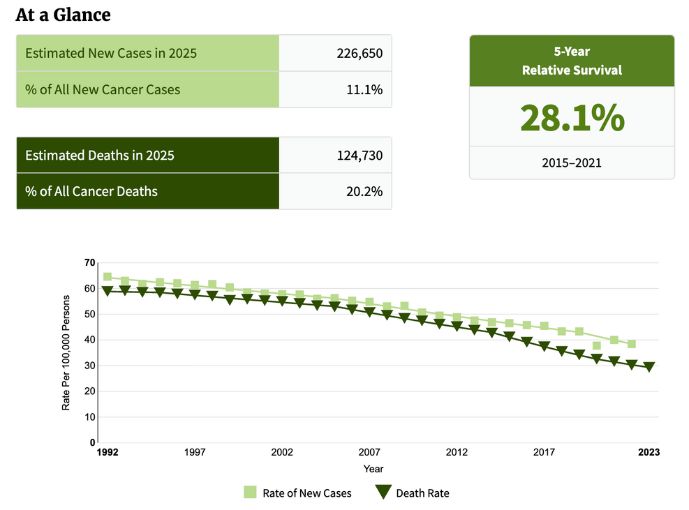
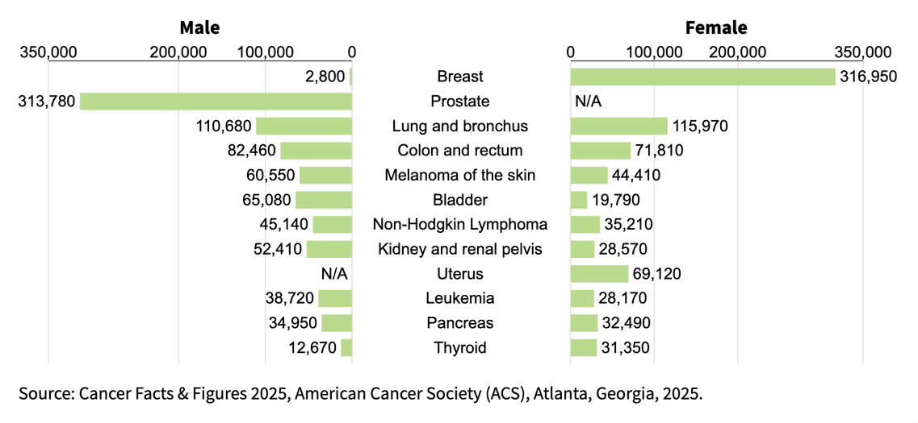
K
a
n
S
u
r
v
i
v
e
Background
2
.
0
Lung Cancer: Epidemiology
  LC is the leading cause of cancer death in the US
  Accounts for about 1 in 5 of all cancer deaths
  Each year, more people die of LC than of colon, breast, and prostate cancers combined.
SEER Cancer Stat Facts: Lung & Bronchus Cancer: https://seer.cancer.gov/statfacts/html/prost.html

Slide 13
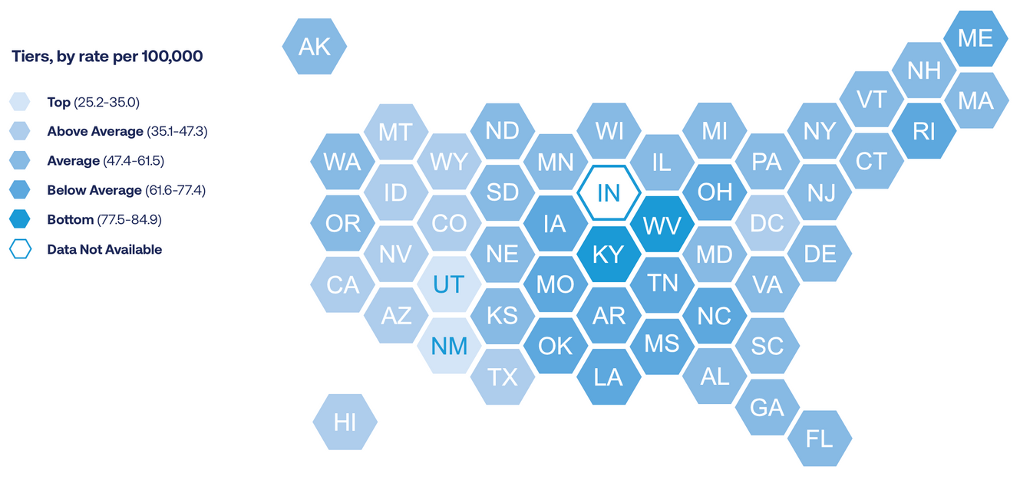
K
a
n
S
u
r
v
i
v
e
Background
2
.
0
Lung Cancer: Epidemiology
  ~235,000 people will be diagnosed with LC this year
  Rates of new cases vary by state:
    Kansas’ incidence rate is 51.9
      National average is 54.6
State Rankings by Rate of New Cases
American Lung Association: State of Lung Cancer 2024

Slide 14
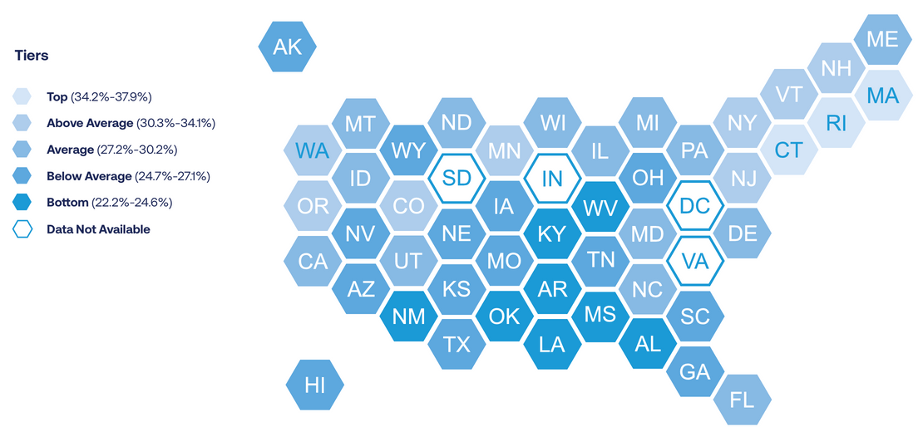
K
a
n
S
u
r
v
i
v
e
Background
2
.
0
Lung Cancer: Survival
  Nationally, overall 5-year survival is 28.4%​
    This is a 26% improvement over the last 5 years
  5-year survival for early stage is 64%​
  Regional variability in survival:
    Massachusetts ranked best at 37.9%
    Oklahoma ranked worst at 22.2%
    Kansas ranked below average at 26.1%
State Rankings by 5-Year Survival Rate
American Lung Association: State of Lung Cancer 2024

Slide 15
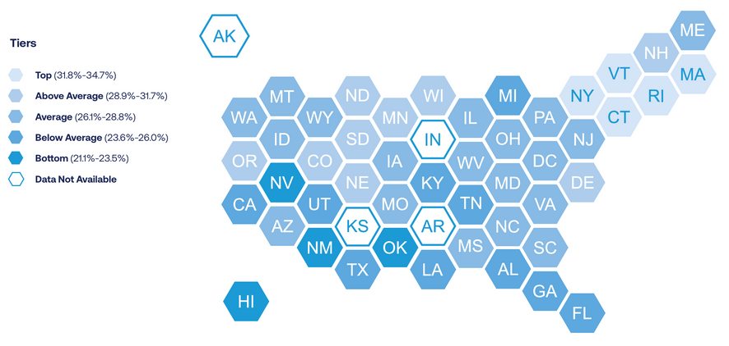
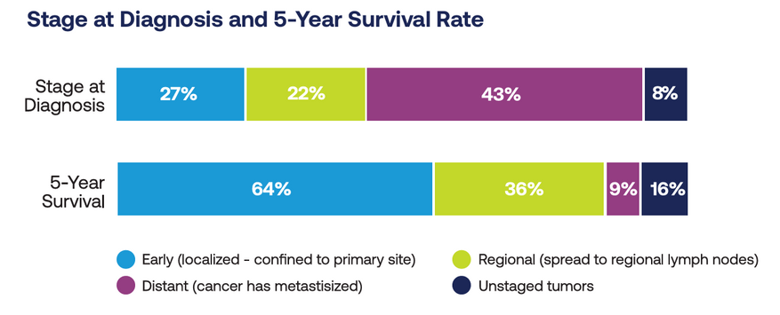
K
a
n
S
u
r
v
i
v
e
Background
2
.
0
Lung Cancer: Early Diagnosis
State Rankings by Early Diagnosis Rate
  Only 27% of cases were diagnosed at an early stage​
    43% of cases are not caught until a late stage when survival is only 9%
  Regional variability in trends for stage of diagnosis​
  Goal is to increase rate of early stage diagnosis through lung cancer screening (LCS)
American Lung Association: State of Lung Cancer 2024
American Lung Association: State of Lung Cancer 2024

Slide 16
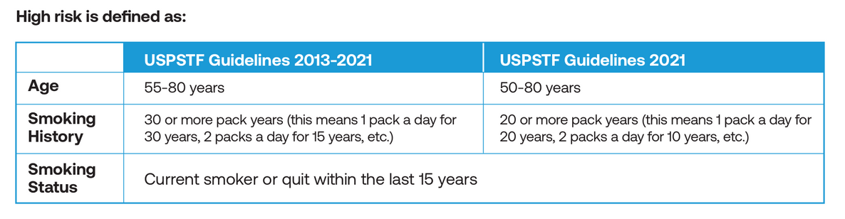
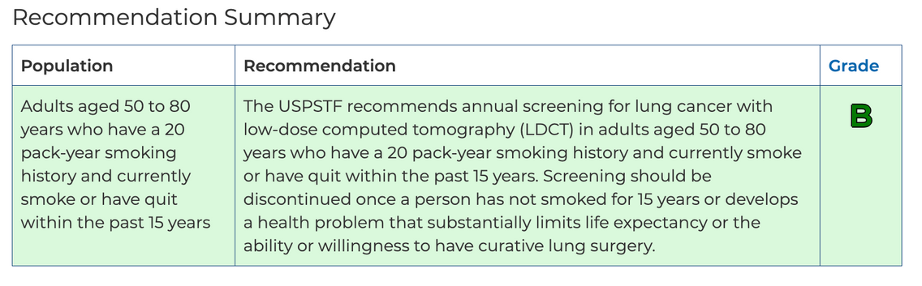
K
a
n
S
u
r
v
i
v
e
Screening
2
.
0
LCS: USPSTF Guidelines
  March 2021 updated recommendations published​
​
  Supporting arguments​
    LDCT clearly has sensitivity/specificity to detect early-stage lung cancer​
    Benefit demonstrated to screen defined high-risk population​
    Harms of early diagnosis/treatment are relatively low relative to mortality benefit
Notes:
In March of 2021, the United States Preventive Services Task Force (USPSTF) expanded its recommendation for screening to include a larger age range and more current and former smokers. This dramatically increased the number of women and Black individuals who are considered at high risk for lung cancer. At the same time, the requirement for screening facilities to participate in the lung cancer screening registry in order to receive reimbursement from Medicare for screening scans was removed, which may have led to a decrease in reported scans, especially in some states.

Slide 17





K
a
n
S
u
r
v
i
v
e
Screening
2
.
0
LCS: Shared Decision Making & Potential Harms
  Shared Decision Making
    SDM vital component of LCS​
    Benefits/risks​
    Tobacco cessation and provision of cessationservices​
    SDM must be documented
Patient goals & preferences
SDM
Clinical evidence & expertise
  Potential Harms
    False-positive - unnecessary invasive procedure​
    Overdiagnosis​
    Radiation-induced cancer​
    Incidental findings​
    Increases in distress and anxiety
Biological, psychological, & sociological context

Slide 18


K
a
n
S
u
r
v
i
v
e
Screening
2
.
0
LCS: Screening Considerations
For screening to be most effective, more of the high-risk population should be screened annually
    National screening rates (16%) remain low among those at high risk
Centralized > decentralized​
  Centralized has benefit of staff to monitor patients, smoking cessation counseling, select scans reviewed by experts at multidisciplinary tumor board​
Lopez-Olivo et al. JAMA. 2020.​
Lam et al. Lung Cancer. 2020​
Smith.Chest.2022​
Nunez.Ann of ATS.2022

Slide 19
K
a
n
S
u
r
v
i
v
e
Treatment Options
2
.
0
Treating Lung Cancer
  LC can often be treated with surgery if it is diagnosed at an early stage and has not spread
  People diagnosed with LC not healthy enough to undergo the procedure or whose cancer has spread may not be candidates for surgery.
  Other treatments may be recommended instead of or in addition to surgery, such as chemotherapy, radiation, targeted therapy or immunotherapy.
American Lung Association: State of Lung Cancer 2024

Slide 20
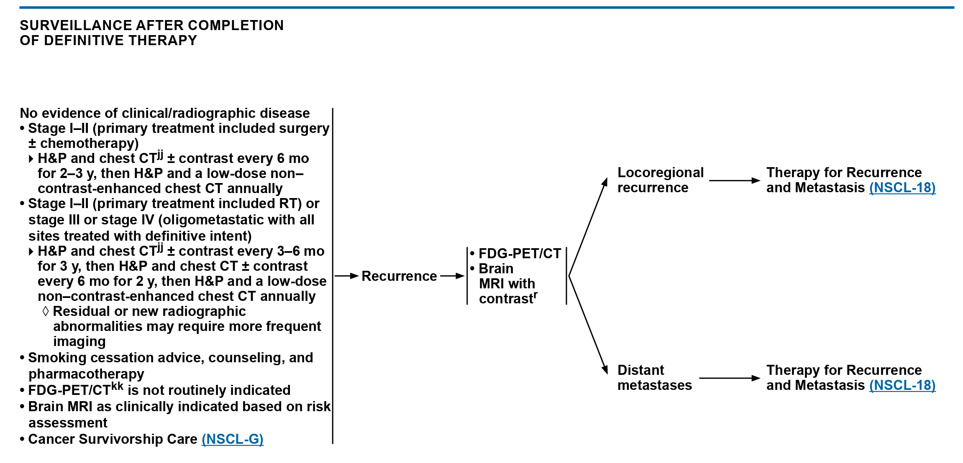
K
a
n
S
u
r
v
i
v
e
Surveillance
2
.
0
NSCLC: Surveillance After Completion of Definitive Therapy
National Comprehensive Cancer Network (NCCN) NSCLC Guidelines, v2. 2025
National Comprehensive Cancer Network (NCCN). NCCN Clinical Practice Guidelines in Oncology (NCCN Guidelines®): Non Small Cell Lung Cancer Cancer. Version 2.2025. Plymouth Meeting, PA: National Comprehensive Cancer Network; 2025. https://www.nccn.org/guidelines/guidelines-detail?category=1&id=1450

Slide 21
K
a
n
S
u
r
v
i
v
e
Common Side Effects & Symptom Burden
2
.
0
High-Impact Symptoms
Affect > 80% of LC survivors:
  Dyspnea – often persistent after resection / radiation (up to 70–80% within 6 months)
  Fatigue – reported by > 50% after surgery; ~80% during chemo/radiation
  Sleep difficulties / insomnia – linked to anxiety, depression, pain, and circadian disruption
  Psychological distress – fear, anxiety, & depressive symptoms 3x higher than in other cancers
  Pain and physical limitation – impaired exercise tolerance, reduced independence, & lower role/social function
  Contributors: loss of lung tissue, chronic pulmonary disease, treatment toxicity, deconditioning, and stigma
Ha et al., Survivorship Challenges and Supportive Care in Lung Cancer. Semin Respir Crit Care Med, 2025.

Slide 22
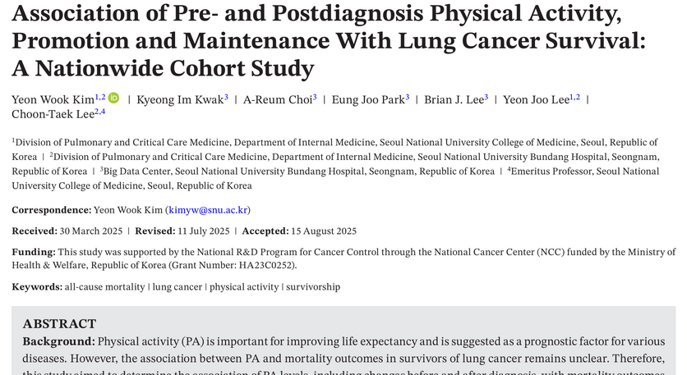
K
a
n
S
u
r
v
i
v
e
Long-Term Follow-up Care
2
.
0
Lung Cancer Survivorship & Exercise
  Both pre- and post-diagnosis physical activity (PA) were independently associated with lower risk of death among lung cancer survivors — reducing all-cause mortality by 8–15% and lung-cancer–specific mortality by 7–11%.
  A dose–response relationship was observed: higher activity levels (measured in MET-minutes per week) corresponded with progressively greater survival benefits.
  Survivors who maintained PA before and after diagnosis had the greatest benefit—23% lower all-cause mortality—while those who became active after diagnosis saw a 9% reduction.
  The minimum clinically important difference (MCID) for achieving mortality benefit was an increase of about 800 MET-minutes/week (~150 minutes of moderate activity weekly).
Individuals who were active before diagnosis but became inactive after lost all survival benefit, underscoring the importance of continued movement throughout survivorship.
Kim YW, Kwak KI, Choi AR, Park EJ, Lee BJ, Lee YJ, Lee CT. Association of Pre- and Postdiagnosis Physical Activity, Promotion and Maintenance With Lung Cancer Survival: A Nationwide Cohort Study. J Cachexia Sarcopenia Muscle. 2025 Oct;16(5):e70092. doi: 10.1002/jcsm.70092. PMID: 41104479; PMCID: PMC12531591.

Slide 23


K
a
n
S
u
r
v
i
v
e
Long-Term Follow-up Care
2
.
0
Smoking Cessation
  Brief advice (~3 minutes) is associated with an increase in smoking abstinence rates
  Encourage an immediate quit attempt, but support reduction w/ pharmacotherapy & counseling
  Discuss (and normalize!) risk of relapse
  Longer periods of abstinence from smoking confer better surgical outcomes but should not delay timing of cancer resection
https://www.kdhe.ks.gov/1800/Quitting-Tobacco
https://www.masoniccanceralliance.org/programs/tobacco-cessation.html
National Comprehensive Cancer Network (NCCN). NCCN Clinical Practice Guidelines in Oncology (NCCN Guidelines®): Smoking Cessation. Version 1.2025. Plymouth Meeting, PA: National Comprehensive Cancer Network; 2025.

Slide 24
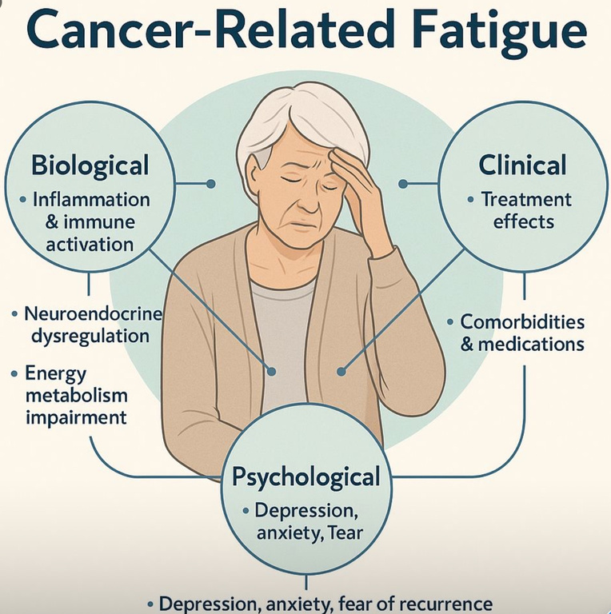
K
a
n
S
u
r
v
i
v
e
Long-Term Follow-up Care
2
.
0
Fatigue
  Encourage physical activity & self-monitor fatigue levels
  Energy conservation:
    Set priorities & realistic expectations
    Pace, delegate, use labor-saving & assistive devices
    Postpone nonessential activities
    Limit naps to not interfere w/ night-time sleep quality
    Have a structured daily routine
    Attend to one activity at a time
  Refer to specialists as appropriate
  Review medications that may be contributing to fatigue; adjust and advise accordingly
  NCCN Guidelines Version 1.2026 - Cancer-Related Fatigue

Slide 25

K
a
n
S
u
r
v
i
v
e
Long-Term Follow-up Care
2
.
0
Psychosocial Sequelae
  Compared with the general population, LC survivors have:
    Worse health-related quality of life (HRQL) with higher stage disease, poor performance status, COPD, and emotional distress.
  Key domains LC survivors ranked as “very important”:
    Performing everyday activities and maintaining independence
    Managing dyspnea and fatigue
    Reducing anxiety and depressive symptoms
  Primary-care focus: proactive screening for physical and psychological symptoms, functional assessment, and coordination with rehab/palliative teams
  Treat distress as a modifiable symptom—normalize discussion of mental health, connect to counseling, pulmonary rehab, and social supports
Studts JL, et. al; Stigma and Nihilism Task Group of the American Cancer Society National Lung Cancer Roundtable. The American Cancer Society National Lung Cancer Roundtable strategic plan: Changing the lung cancer story: Addressing survivorship, stigma, and nihilism to facilitate transformation. Cancer. 2025 Aug 15;131(16):e35969. doi: 10.1002/cncr.35969. PMID: 40781853.
Ha et al., Survivorship Challenges and Supportive Care in Lung Cancer. Semin Respir Crit Care Med, 2025.
NCCN Guidelines Version 2.2025. Distress Management

Slide 26

K
a
n
S
u
r
v
i
v
e
Long-Term Follow-up Care
2
.
0
Financial Toxicity
  Financial toxicity is linked to downstream negative health outcomes: medication non-adherence, delayed care, poorer quality of life, and even increased mortality risk.
  Cancer survivors frequently face significant out-of-pocket costs, income loss, employment disruption, and debt, even when insured.
  Among lung cancer survivors, patients experience increased unemployment and lower wages compared to the general population underscoring the lasting effects of financial toxicity.
  PCPs are in a strategic position to screen for financial distress, ask about cost‐related barriers (e.g., skipping meds, avoiding imaging), and refer patients early to financial navigators/support services.
Boulanger M, Mitchell C, Zhong J, Hsu M. Financial toxicity in lung cancer. Front Oncol. 2022 Oct 21;12:1004102. doi: 10.3389/fonc.2022.1004102. PMID: 36338686; PMCID: PMC9634168.
Ha et al., Survivorship Challenges and Supportive Care in Lung Cancer. Semin Respir Crit Care Med, 2025.

Slide 27

K
a
n
S
u
r
v
i
v
e
Preventive & Health Maintenance
2
.
0
Primary Care Actions
  Document diagnosis in Problem List, tx received, current therapy status
  Immunizations - influenza, herpes zoster, pneumococcal, COVID, hepatitis
  Encourage & integrate exercise and pulmonary rehab referrals
  Screen for fatigue, sleep disturbance, and mood at routine visits
  Encourage complementary, evidence-based mind-body practices
  Use EHR tools (prompts for surveillance screening)
  Assess smoking status and offer support for quitting
  Assess for distress, fatigue, financial issues
  Coordinate survivorship and palliative care to optimize whole-person health
National Comprehensive Cancer Network (NCCN). NCCN Clinical Practice Guidelines in Oncology (NCCN Guidelines®): Non Small Cell Lung Cancer Cancer. Version 2.2025. Plymouth Meeting, PA: National Comprehensive Cancer Network; 2025. https://www.nccn.org/guidelines/guidelines-detail?category=1&id=1450

Slide 28
K
a
n
S
u
r
v
i
v
e
2
.
0
Q&A
QUESTIONS?

Slide 29

K
a
n
S
u
r
v
i
v
e
Case Study
2
.
0
Privacy
Please only display or say information that does not identify a patient or that can not be linked to a patient.​
​
Photos used are freely available on the internet.

Slide 30

K
a
n
S
u
r
v
i
v
e
LC Survivorship Case Study: Dawn’s Story
2
.
0
Name: Robin
Age: 54 years, Sex: Female
Occupation: retired, substitute teacher at grandchildren’s elementary school
Past Medical History: Seasonal allergies, mild hypertension (well-controlled)
Smoking History: 1 pack/day for ~20 years; quit 10 years ago (20 pack-years)
Current Medications: Hydrochlorothiazide 12.5 mg daily, loratadine as needed
Symptoms: Persistent dry cough for >4 months, fatigue, mild shortness of breath on exertion
Robin

Slide 31
LC Survivorship Case Study: Dawn’s Story
K
a
n
S
u
r
v
i
v
e
2
.
0
Clinical Scenario:
  Dawn presents to her PCP for a routine visit, noting an ongoing cough that “just won’t go away.” She attributes it to allergies or post-nasal drip.
  A chest x-ray is ordered and read as “nonspecific.”
  No low-dose CT (LDCT) screening was ordered because she had quit smoking more than 10 years ago and was not automatically flagged as “screen-eligible.”
  Six months later, she presents with worsening cough and chest discomfort. A CT scan reveals a 2.3 cm right upper lobe nodule, confirmed as stage IIA non–small cell lung cancer (NSCLC).
  She undergoes surgical resection and adjuvant chemotherapy.
Robin

Slide 32
LC Survivorship Case Study: Dawn’s Story
K
a
n
S
u
r
v
i
v
e
2
.
0
Key Considerations
Screening Eligibility Awareness:
  USPSTF guidelines, annual LDCT screening is recommended for adults aged 50–80 years with a ≥20 pack-year smoking history who currently smoke or quit within the past 15 years.
  Robin’s 20 pack-year history means she would have been eligible—despite having quit 11 years ago.
EHR & Workflow Optimization:
  Document quit date and pack-years in structured EHR fields so eligibility reminders trigger correctly.
  Implement clinical decision support tools that alert providers when patients fall within screening criteria.
Robin

Slide 33
LC Survivorship Case Study: Dawn’s Story
K
a
n
S
u
r
v
i
v
e
2
.
0
Key Considerations, cont.
Early Detection Matters:
  Stage I–II lung cancers have a 5-year survival of 60–70%, compared to <20% for advanced stages.
  PCPs are often the first to evaluate subtle or chronic symptoms (like cough), creating a critical window for early detection.
Survivorship and Long-Term Care:
  After treatment, Dawn requires surveillance CT every 6–12 months for 2 years, then annually.
  Primary care supports smoking cessation reinforcement, management of comorbidities, monitoring for late effects (fatigue, neuropathy, pulmonary changes), and psychosocial well-being.
Robin
Robin’s story underscores the importance of accurate smoking history capture, routine screening discussions, and patient education about the purpose and benefits of LDCT screening—even years after quitting.

Slide 34
COMING UP NEXT
K
a
n
S
u
r
v
i
v
e
2
.
0
Wednesday, November 12th at Noon
Colorectal Cancer Survivorship in Rural Primary Care Practice
Guest Speakers:
Allen Greiner, MD & Chelsea Johanson, PA-C
KUMC and The University of Kansas Health System

Slide 35
K
a
n
S
u
r
v
i
v
e
2
.
0
THANK YOU
kansurvive.com

