Slide 1











K
a
n
S
u
r
v
i
v
e
2
.
0
Testing Enhanced Models of Cancer Survivorship Care for Rural Cancer Survivors in Primary Care Practice
Colorectal Cancer Survivorship in Rural Primary Care
kansurvive.com
Allen Greiner, MD, MPH
Nason Family Endowed Professor and Vice Chair of Research and Community Health with the Department of Family Medicine and Community Health at the University of Kansas Medical Center
Chelsea Johanson, PA-C
Advanced practice provider in Hemetology-Oncology at the University of Kansas Cancer Center and The University of Kansas Health System

Slide 2

K
a
n
S
u
r
v
i
v
e
AGENDA
2
.
0
Time | Presentation | Presenter
12:00 - 12:05 pm | Welcome & Introductions | Team
12:05 - 12:15 pm | Cancer Survivorship Review | Jennifer Klemp, PhD
12:15 - 12:45 pm | Didactic: Colorectal Cancer Survivorship | Allen Greiner, MD & Chelsea Johanson, PA-C
12:45 - 12:55 pm | Case Presentation & Discussion | Dr. Greiner, Chelsea, & Team
12:55 - 1:00 pm | Wrap-up & Announcements | Team
kansurvive.com

Slide 3


K
a
n
S
u
r
v
i
v
e
RECORDING & TIPS
2
.
0
  Mute yourself when not speaking.​
  Turn your camera on – we would love to see you!​
  Speak up, use the chat box, and actively engage.​
  Visit www.kansurvive.com for session materials.
kansurvive.com
By participating in this ECHO clinic, you are consenting to be recorded.
Recording is for educational and quality improvement purposes.​

Slide 4


K
a
n
S
u
r
v
i
v
e
CONTINUING EDUCATION CREDIT
2
.
0
In support of improving patient care, University of Kansas Medical Center is jointly accredited by the Accreditation Council for Continuing Medical Education (ACCME), the Accreditation Council for Pharmacy Education (ACPE), and the American Nurses Credentialing Center (ANCC), to provide continuing education for the healthcare team.​
Physician: ​
The University of Kansas Medical Center designates this live activity for a maximum of 1 AMA PRA Category 1 Credit™. Physicians should claim only the credit commensurate with the extent of their participation in the activity.​
Physician Assistant:
The University of Kansas Medical Center has been authorized by the American Academy of PAs (AAPA) to award AAPA Category 1 CME credit for activities planned in accordance with AAPA CME Criteria. This activity is designated for 1 AAPA Category 1 CME credits. PAs should only claim credit commensurate with the extent of their participation.
​Nursing: ​
The University of Kansas Medical Center designates this activity for a maximum of 1 ANCC contact hours. Nurses should claim only
the credit commensurate with the extent of their participation in the activity.​
​
Certificate of Attendance:​
Certificates of attendance are available to other participants upon completion of documentation of attendance and evaluation as outlined​
​
Attendance requirement : ​
Participants missing more than 10% of this offering will not receive continuing education credit.​
Continuing Education provided by KU Area Health Education Center | www.kumc.edu/ahec | checkahec@kumc.edu
kansurvive.com

Slide 5

K
a
n
S
u
r
v
i
v
e
DOCUMENTING ATTENDANCE
2
.
0
Take a photo of this slide or write down the code. It will not be released after session ends.
57tets (five seven T E T S)
NOTE: The deadline to enter the sign-in code is November 19, 2025 @ 5:00 PM
You may enter the sign-in code to complete the course evaluation by:
Text the activity identification code to (828) 295-1144, OR
Access www.eeds.com from a mobile device or PC and enter the activity identification code, OR
Download the eeds mobile app (iOS, Android) and use the activity identification code to sign-in to events, OR
Scan the QR code on the left.
kansurvive.com
Once your attendance is confirmed via the Zoom Roster, and that you have met all attendance requirements, you will receive an e-mail that your certificate is available 7-10 business days post event.
Continuing Education provided by KU Area Health Education Center | www.kumc.edu/ahec | checkahec@kumc.edu

Slide 6
K
a
n
S
u
r
v
i
v
e
DISCLOSURES
2
.
0
Below contains disclosure of all financial relationships with any ineligible companies from individuals involved in planning, design and/or implementation of this offering over the past 24 months. We define ineligible companies as those whose primary business is producing, marketing, selling, re-selling, or distributing healthcare products used by or on patients.
The following presenters/moderators/panelists/planning committee members report no relationships
of a financial, professional or personal nature with ineligible companies over the past 24 months:
Karen Aufdemberge, RN; Allen Greiner, MD; Catie Knight, MPH; Jennifer McKenney, MD; Chelsea Johanson, PA-C
The following presenters/moderators/panelists/planning committee members have disclosed relationships of a financial, professional or personal nature with ineligible companies over the past 24 months:
Jennifer Klemp, PhD
Caris Life Science, Inc.: Stock Options, Salary
All Financial Relationships have been mitigated.
kansurvive.com
Continuing Education provided by KU Area Health Education Center | www.kumc.edu/ahec | checkahec@kumc.edu

Slide 7
K
a
n
S
u
r
v
i
v
e
COMMERCIAL / NON-COMMERICAL SUPPORT
2
.
0
There is no commercial support for this CE activity. ​
kansurvive.com
Continuing Education provided by KU Area Health Education Center | www.kumc.edu/ahec | checkahec@kumc.edu

Slide 8
K
a
n
S
u
r
v
i
v
e
FUNDING SOURCE
2
.
0
This project is funded by the National Cancer Institute (U01CA290664-01) with additional support from the University of Kansas Cancer Center (KUCC), Masonic Cancer Alliance (MCA), Kansas Patients and Providers Engaged in Prevention Research (KPPEPR), and Frontiers CTSA .
kansurvive.com

Slide 9

K
a
n
S
u
r
v
i
v
e
Learning Objectives
2
.
0
Learning Objectives
By the end of this session, participants will be able to:
  Describe the core components of colorectal cancer survivorship care
  Recognize common long-term and late effects of colorectal cancer treatment
  Apply colorectal cancer survivorship care guidelines to routine primary care
  Use tools and documentation strategies to support colorectal cancer survivors
Continuing Education provided by KU Area Health Education Center | www.kumc.edu/ahec | checkahec@kumc.edu

Slide 10

K
a
n
S
u
r
v
i
v
e
Introduction
2
.
0
Colorectal Cancer Survivorship in Primary Care
The Main Points
Colorectal cancer survivors are living longer, shifting long-term follow-up and symptom management into primary care.
Survivors often face persistent physical, gastrointestinal, and psychosocial effects that impact daily functioning and quality of life.
Primary care providers play a central role in monitoring recurrence, managing late and long-term treatment effects, and addressing preventive care needs.
Rural settings face added barriers, increasing the importance of structured workflows, EHR optimization, use of guideline-driven recommendations and team-based approaches to survivorship care.

Slide 11
K
a
n
S
u
r
v
i
v
e
2
.
0
Introduction
Introducing Our guest speakers today...
Colorectal Cancer Survivorship in Rural Primary Care
Allen Greiner, MD & Chelsea Johanson, PA-C

Slide 12
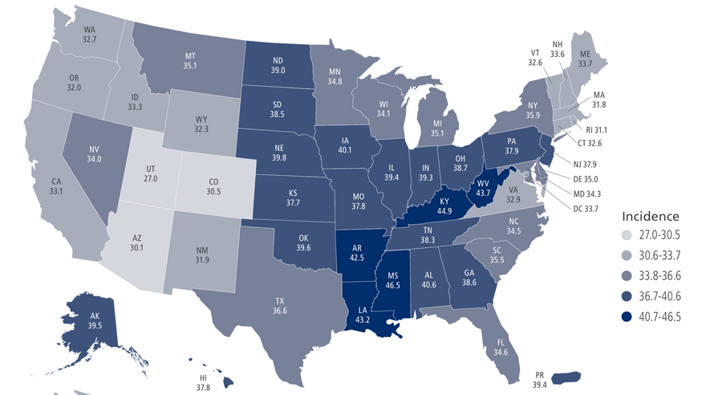
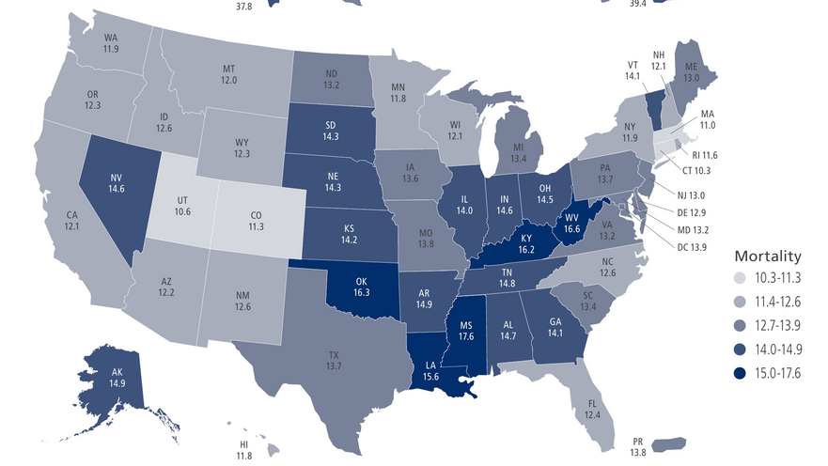
K
a
n
S
u
r
v
i
v
e
Background
2
.
0
Colorectal Cancer (CRC): Epidemiology
    Incidence rate: 37.1 per 100,000*
    Mortality rate: 12.9 per 100,000*
    Prevalence rate: ~1.42 million people living with a hx of CRC in the U.S.*
  Risk increases with age
    most frequently diagnosed among US adults 65-74 yrs
  Driving factors
    obesity, sedentary lifestyle, red meat consumption, alcohol & tobacco use
154, 279 new cases & 52,900 deaths projected for 2025 (colon + rectum combined)
(based on 2018–2022 cases and 2019–2023 deaths)
Siegel RL, Wagle NS, Cercek A, Smith RA, Jemal A. Colorectal cancer statistics, 2023. CA Cancer J Clin. 2023 May-Jun;73(3):233-254. doi: 10.3322/caac.21772. Epub 2023 Mar 1. PMID: 36856579.
American Cancer Society (ACS), Cancer Facts & Figures 2025 — “Estimated Number of New Cancer Cases and Deaths, US, 2025.”
CDC, U.S. Cancer Statistics (USCS): “Colorectal Cancer Stat Bite” (posted June 2025).
NCI SEER, Cancer Stat Facts: Colorectal Cancer — national rates, lifetime risk, and prevalence.

Slide 13
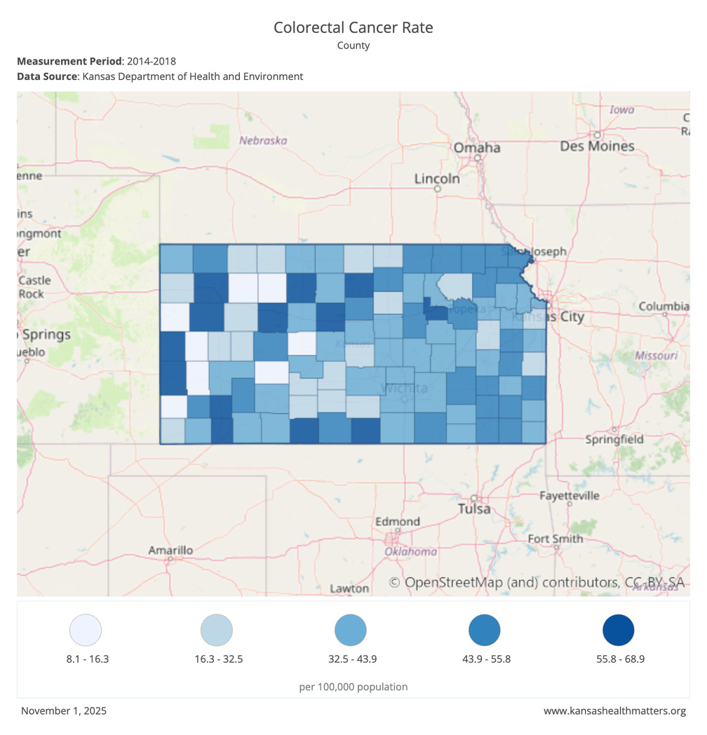
K
a
n
S
u
r
v
i
v
e
Background
2
.
0
CRC Epidemiology
  In Kansas, CRC was the 3rd most diagnosed cancer and 3rd leading cause of cancer death among Kansas adults during the 2017-2021 period.
  During 2013-2017, the age-adjusted incidence rate for CRC was higher in rural counties compared to urban ones.

Slide 14
K
a
n
S
u
r
v
i
v
e
Background
2
.
0
Early-Onset Colorectal Cancer (EOCRC): What We Know
  Rapidly rising incidence: EOCRC is now a leading cause of cancer deaths among adults under 50
  Distinct biology: Tumors in younger adults are more often left-sided (rectum/left colon) and may have more aggressive molecular features.
  Genetic predisposition: Around 1 in 5 patients under age 35 carry a hereditary cancer mutation (e.g., Lynch syndrome, BRCA1/2), but this does not fully explain the population-level rise.
  Mortality shift: Deaths from colorectal cancer are increasing among younger adults, while overall cancer mortality in this age group is not.
Despite continued overall declines, CRC is rapidly shifting to diagnosis at a younger age, at a more advanced stage, and in the left colon/rectum.
Siegel RL, Wagle NS, Cercek A, Smith RA, Jemal A. Colorectal cancer statistics, 2023. CA Cancer J Clin. 2023 May-Jun;73(3):233-254. doi: 10.3322/caac.21772. Epub 2023 Mar 1. PMID: 36856579.
Saraiva MR, Rosa I, Claro I. Early-onset colorectal cancer: A review of current knowledge. World J Gastroenterol. 2023 Feb 28;29(8):1289-1303. doi: 10.3748/wjg.v29.i8.1289. PMID: 36925459; PMCID: PMC10011966.

Slide 15

K
a
n
S
u
r
v
i
v
e
Background
2
.
0
EOCRC: Clinical Implications
Despite continued overall declines, CRC is rapidly shifting to diagnosis at a younger age, at a more advanced stage, and in the left colon/rectum.
  How PCPs can help:
    Support screening awareness and participation beginning at age 45 (per USPSTF and ACS guidelines).
      Document family history of cancer (ideally a third degree pedigree)
    Encourage earlier diagnostic evaluation for persistent GI symptoms in younger adults.
National Cancer Institute. As Rates of Some Cancers Increase in Younger People, Researchers Search for Answers. Cancer Currents Blog, May 14, 2025.
Saraiva MR, Rosa I, Claro I. Early-onset colorectal cancer: A review of current knowledge. World J Gastroenterol. 2023 Feb 28;29(8):1289-1303. doi: 10.3748/wjg.v29.i8.1289. PMID: 36925459; PMCID: PMC10011966.

Slide 16

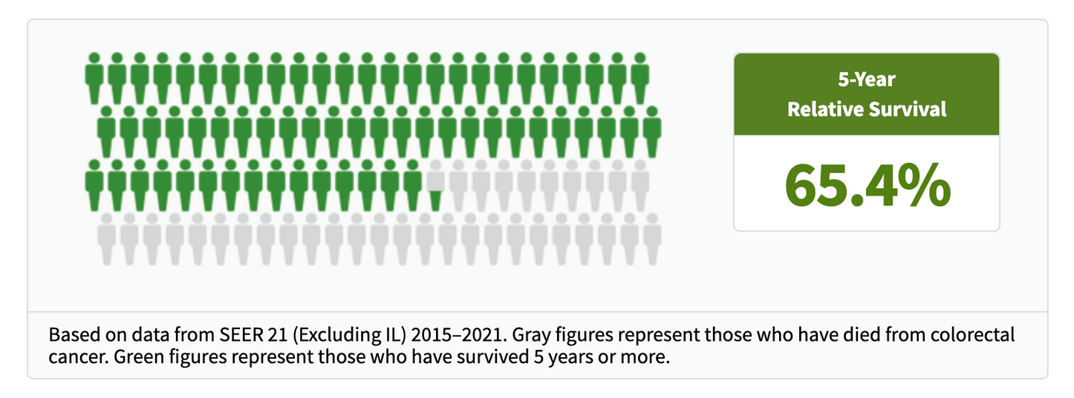
K
a
n
S
u
r
v
i
v
e
Background
2
.
0
CRC Survival
  5-year relative survival for CRC is 65.4%
    However, this varies significantly by stage

Slide 17
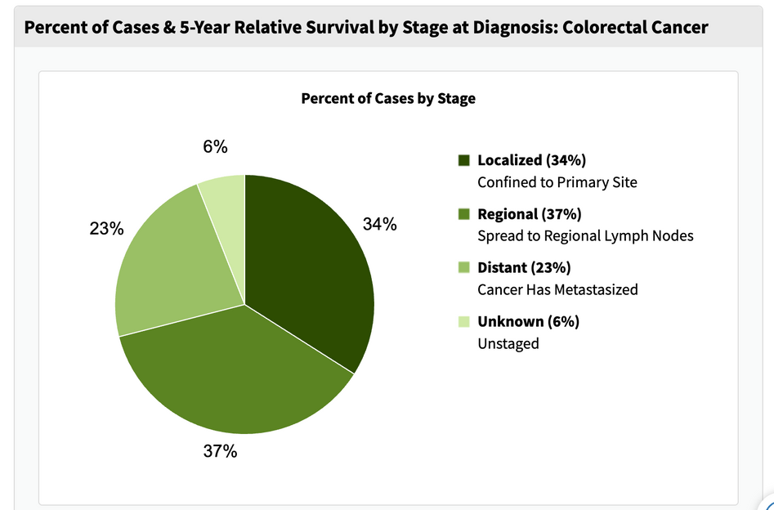
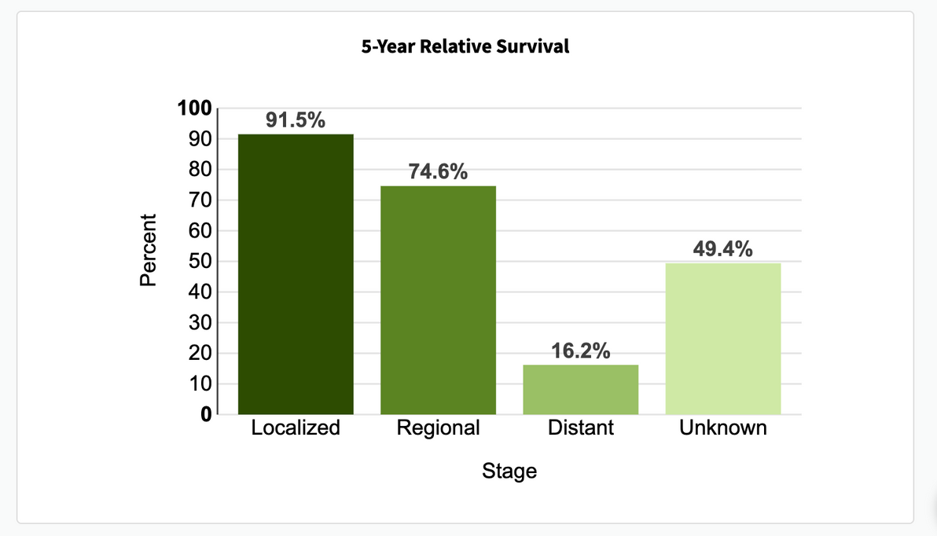
K
a
n
S
u
r
v
i
v
e
Background
2
.
0
CRC Early Diagnosis
  5-year relative survival for localized CRC is 91.5%
    34.2% are diagnosed at the local stage

Slide 18
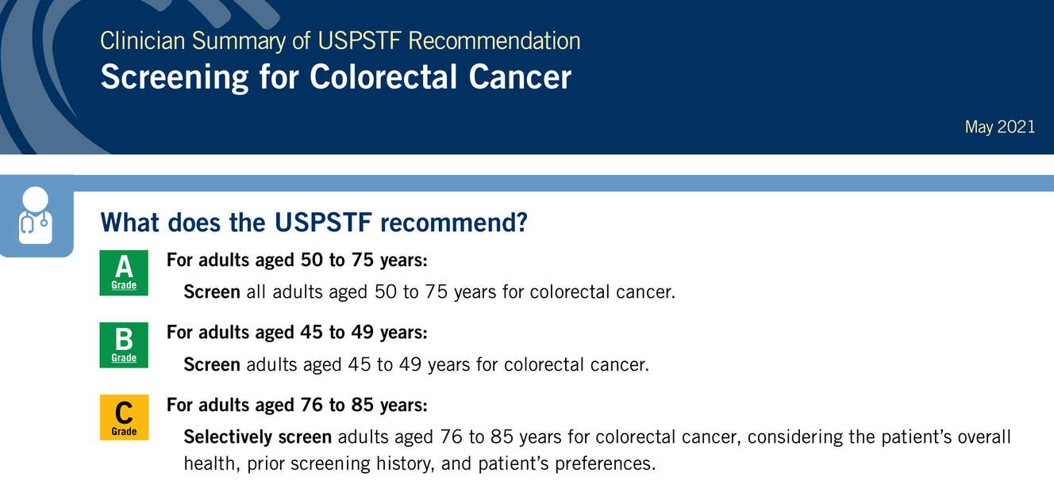
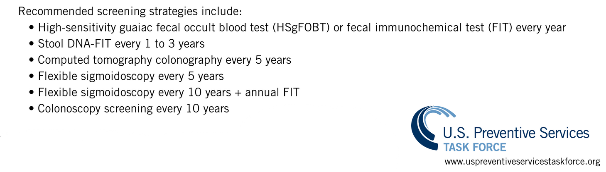
K
a
n
S
u
r
v
i
v
e
Screening
2
.
0
CRC Screening: USPSTF Guidelines
Notes:
In March of 2021, the United States Preventive Services Task Force (USPSTF) expanded its recommendation for screening to include a larger age range and more current and former smokers. This dramatically increased the number of women and Black individuals who are considered at high risk for lung cancer. At the same time, the requirement for screening facilities to participate in the lung cancer screening registry in order to receive reimbursement from Medicare for screening scans was removed, which may have led to a decrease in reported scans, especially in some states.

Slide 19
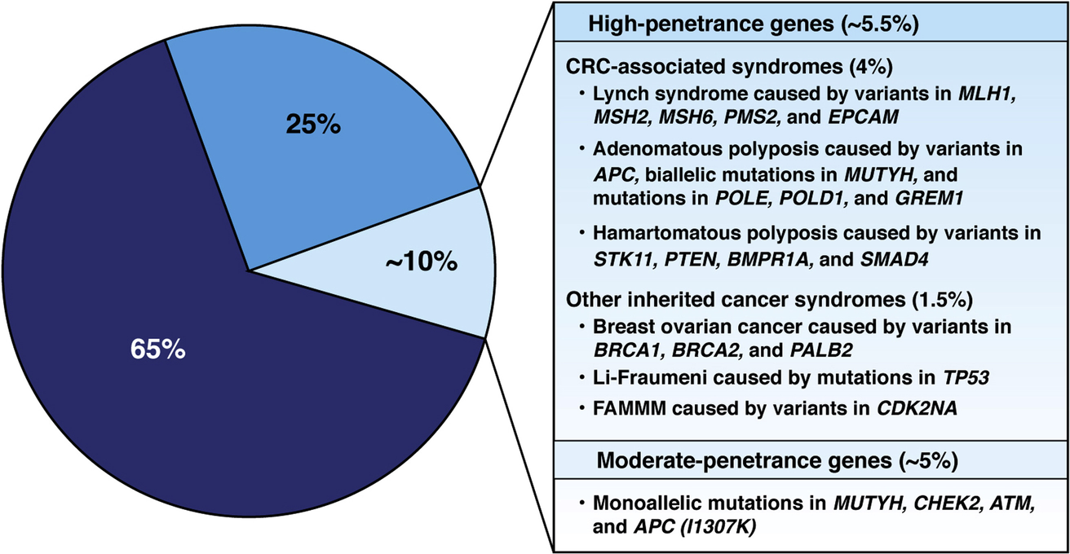
K
a
n
S
u
r
v
i
v
e
Screening
2
.
0
CRC Risk Stratification
  About 35% of those diagnosed with CRC have a family history of the disease, due to shared genetic factors, environmental exposures, or both.
  High- or moderate-penetrance genetic variants account for only 5–10% of all CRC cases.
  Most familial cases are not linked to known hereditary cancer syndromes.
    This broader category is known as common familial CRC, reflecting shared familial risk without identifiable pathogenic variants.
Notes:
In March of 2021, the United States Preventive Services Task Force (USPSTF) expanded its recommendation for screening to include a larger age range and more current and former smokers. This dramatically increased the number of women and Black individuals who are considered at high risk for lung cancer. At the same time, the requirement for screening facilities to participate in the lung cancer screening registry in order to receive reimbursement from Medicare for screening scans was removed, which may have led to a decrease in reported scans, especially in some states.

Slide 20


K
a
n
S
u
r
v
i
v
e
Screening
2
.
0
Average vs Increased Risk
  USPSTF recommendations apply to average-risk* asymptomatic adults
  For higher-risk** patients
    NCCN guidelines: anyone with a first-degree relative with CRC should start screening at age 40 and be screened every 5-10 years.
  Family cancer history remains an important risk assessment tool.
* no personal history of CRC or adenomatous polyps, no inflammatory bowel disease, no known hereditary colorectal cancer syndromes, no strong family history
** family history, polyps, IBD, hereditary syndromes) other more aggressive screening and surveillance guidelines apply
NCCN Guidelines Version 2.2025
- Colorectal Cancer Screening
Notes:
In March of 2021, the United States Preventive Services Task Force (USPSTF) expanded its recommendation for screening to include a larger age range and more current and former smokers. This dramatically increased the number of women and Black individuals who are considered at high risk for lung cancer. At the same time, the requirement for screening facilities to participate in the lung cancer screening registry in order to receive reimbursement from Medicare for screening scans was removed, which may have led to a decrease in reported scans, especially in some states.

Slide 21





K
a
n
S
u
r
v
i
v
e
Screening
2
.
0
CRC Screening: Practical Considerations for Primary Care
  Ask about & document Family History of Cancer
    Note red-flags (e.g., early onset, strong family history, known genetic mutation in family member) and refer for genetic counseling
  Recommend screening & engage patients in shared decision‐making
    Discuss starting age, choice of test, pros/cons, cost/coverage
  Timely follow-up of abnormal non-colonoscopy screening is critical
  EHR reminders / clinic workflows to prompt patients age 45
    Flag patients not up to date, track completion
  Coordinate with oncology or GI for surveillance beyond average risk
Patient goals & preferences
Clinical evidence & expertise
SDM
Biological, psychological, & sociological context
Notes:
In March of 2021, the United States Preventive Services Task Force (USPSTF) expanded its recommendation for screening to include a larger age range and more current and former smokers. This dramatically increased the number of women and Black individuals who are considered at high risk for lung cancer. At the same time, the requirement for screening facilities to participate in the lung cancer screening registry in order to receive reimbursement from Medicare for screening scans was removed, which may have led to a decrease in reported scans, especially in some states.

Slide 22
K
a
n
S
u
r
v
i
v
e
Treatment
2
.
0
Treating Colorectal Cancer
Treatment for CRC is highly stage-dependent
  Ranges from localized surgical resection for early-stage disease to combinations of surgery, chemotherapy, radiation, and targeted or immunotherapy for advanced stages
Stage of CRC diagnosis: | Treatment may include:
Stage 0 (carcinoma in situ) | Surgery Simple polypectomy Local excision Resection & anastomosis
Stages I & II | Surgery Resection & anastomosis
Stage III | Surgery Resection & anastomosis Chemotherapy
Stage IV & recurrent CRC | Surgery Local excision Resection w/wo anastomosis Tumor debulking Radiation Chemotherapy Palliative Care Targeted therapy
National Comprehensive Cancer Network. NCCN Clinical Practice Guidelines in Oncology: Colon Cancer, Version 5.2025. Published 2025

Slide 23
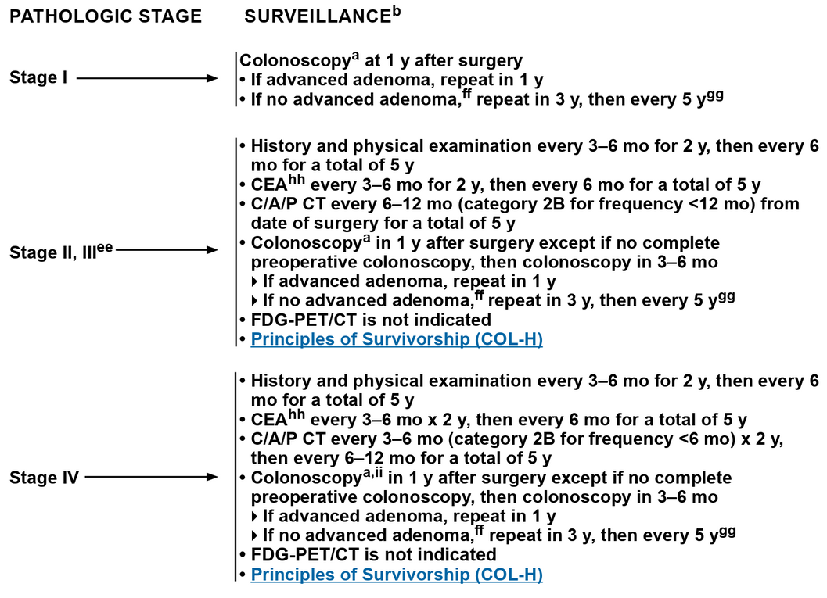
K
a
n
S
u
r
v
i
v
e
Surveillance
2
.
0
Surveillance After Completion of Definitive Therapy
National Comprehensive Cancer Network (NCCN) Colon Cancer Guidelines, v5. 2025
  Routine CEA monitoring and routine CT scanning are not recommended beyond 5 years
National Comprehensive Cancer Network. NCCN Clinical Practice Guidelines in Oncology: Colon Cancer, Version 5.2025. Published 2025

Slide 24
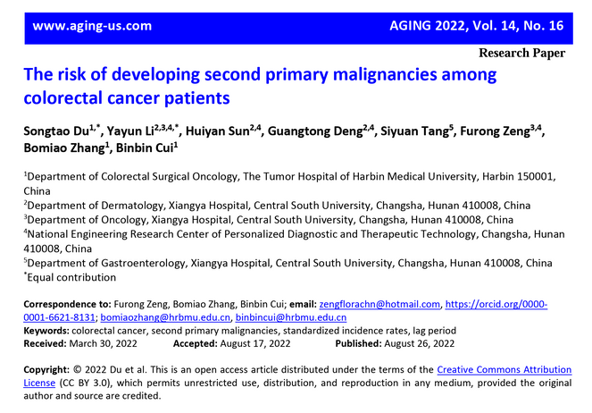
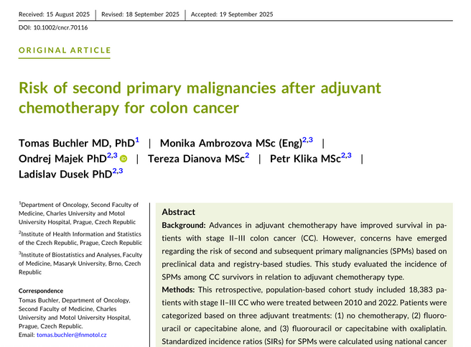
K
a
n
S
u
r
v
i
v
e
Surveillance
2
.
0
Risk of Subsequent Primary Malignancies (SPMs)
  2022 meta‐analysis (Du, et al) of data from over 1.5 million CRC survivors across 42 studies reported a moderately increased risk for SPMs
  2025 study evaluated the incidence of SPMs among CRC survivors in relation to adjuvant chemotherapy type
    Patients tx with oxaliplatin = higher risk of SPM, particularly a second CRC compared to those on other regimens or no chemotherapy
    Key risk factors for SPM include older age, male sex, and the extent of the original disease
Buchler T, Ambrozova M, Majek O, Dianova T, Klika P, Dusek L. Risk of second primary malignancies after adjuvant chemotherapy for colon cancer. Cancer. 2025 Oct 15;131(20):e70116. doi: 10.1002/cncr.70116. PMID: 41060089; PMCID: PMC12506602.
Du S, Li Y, Sun H, et al. The risk of developing second primary malignancies among colorectal cancer patients. Aging (Albany NY). 2022; 14(16): 6756-6779. doi:10.18632/aging.204250

Slide 25

K
a
n
S
u
r
v
i
v
e
Common Side Effects & Symptom Burden
2
.
0
CRC Long-Term Side Effects
  Once side effects from primary treatments subside, many CRC survivors continue to report a high burden of symptoms
  Side effects from primary treatments tend to be most prominent during the first three years post treatment, however...
    Long-term effects of treatment can persist and is a major factor associated with QoL post-treatment
Long-term effects of CRC treatment can include:
  fatigue
  sleep difficulty
  fear of recurrence
  anxiety
  depression
  negative body image
  sensory neuropathy
  GI problems
  urinary incontinence
  sexual dysfunction
Denlinger CS, Barsevick AM. The challenges of colorectal cancer survivorship. J Natl Compr Canc Netw. 2009 Sep;7(8):883-93; quiz 894. doi: 10.6004/jnccn.2009.0058. PMID: 19755048; PMCID: PMC3110673.

Slide 26
K
a
n
S
u
r
v
i
v
e
Common Side Effects & Symptom Burden
2
.
0
Long-Term Symptoms by Age at Diagnosis
A cross-sectional study published in 2015 investigated the functional outcomes and symptoms among 1,215 long-term (>5 years) CRC survivors.
  Results
    830 survivors responded about 11 years post-diagnosis
  Treatment Differences
    Younger-onset survivors had higher rates of surgery (97.9% vs 93.6%) and chemotherapy (86.1% vs 77.7%)
  Common Long-Term Concerns
    Anxiety, body image issues, sexual dysfunction, embarrassment with bowel movements, urinary problems, and impotence
  Age-Related Symptom Patterns
    Younger-onset survivors reported more anxiety, body image distress, and embarrassment with bowel movements.
    Later-onset survivors more often experienced sexual dysfunction, urinary issues, and impotence.
  Key Finding
    Age at diagnosis independently influenced long-term function and symptom burden
Christina E. Bailey, et. al,. Functional Deficits and Symptoms of Long-Term Survivors of Colorectal Cancer Treated by Multimodality Therapy Differ by Age at Diagnosis, Journal of Gastrointestinal Surgery, Volume 19, Issue 1, 2015, Pages 180-188, SSN 1091-255X, https://doi.org/10.1007/s11605-014-2645-7.

Slide 27
K
a
n
S
u
r
v
i
v
e
Common Side Effects & Symptom Burden
2
.
0
Symptom Burden in CRC Survivors
  In a 2020 systematic review of symptom burden in CRC survivors found multiple adverse symptoms related to distinct risk factors.
  Highest frequency
    Body image distress (78.5%)
  Highest severity
    Fatigue (mean 50.1 on 0–100 scale)
  Other major issues
    GI symptoms, psychological distress, peripheral neuropathy, insomnia
  Risk factors
    Younger age, female gender, low family/social support
  Impact on Survivors & Caregivers
    Symptoms impaired QoL, social & sexual functioning, financial well-being
    Caregivers also experienced declines in physical and mental health
  Summary:
    CRC survivors face multiple, persistent adverse symptoms with meaningful impacts on daily life
Han CJ, Yang GS, Syrjala K. Symptom Experiences in Colorectal Cancer Survivors After Cancer Treatments: A Systematic Review and Meta-analysis. Cancer Nurs. 2020 May/Jun;43(3):E132-E158. doi: 10.1097/NCC.0000000000000785. PMID: 32000174; PMCID: PMC7182500.

Slide 28
K
a
n
S
u
r
v
i
v
e
Common Side Effects & Symptom Burden
2
.
0
GI Problems in CRC Survivors
  Chronic diarrhea is common
    Nearly half of CRC survivors experience chronic diarrhea
  Effective treatments
    Antidiarrheals (loperamide, diphenoxylate/atropine) are first-line
    Low-fat or elemental diets, avoidance of raw vegetables, and probiotics can help after pelvic radiation
  Fecal incontinence management
    Antidiarrheals, methylcellulose for stool bulking, biofeedback therapies, and select procedural or surgical options
  Radiation proctopathy
    Persistent rectal bleeding warrants referral for endoscopic treatment
Burgers K, Moore C, Bednash L. Care of the Colorectal Cancer Survivor. Am Fam Physician. 2018 Mar 1;97(5):331-336. PMID: 29671505.
National Comprehensive Cancer Network. NCCN Clinical Practice Guidelines in Oncology: Colon Cancer, Version 5.2025. Published 2025
El-Shami K, Oeffinger KC, Erb NL, et al. American Cancer Society colorectal cancer survivorship care guidelines. CA Cancer J Clin. 2015;65(6):428-455.

Slide 29

K
a
n
S
u
r
v
i
v
e
Common Side Effects & Symptom Burden
2
.
0
GI Problems in Female CRC Survivors
Researchers recently conducted a cross-sectional study using data from the Women’s Health Initiative (WHI) Life and Longevity After Cancer (LILAC) study that recruited postmenopausal women (N=413).
  Results
    N = 413 postmenopausal, female, CRC survivors
    Mean age 71.2 yrs,
    Mean time since diagnosis = 8.1 yrs
    81% experienced persistent GI symptoms
  Most prevalent symptoms:
    Bloating/gas (54%), constipation (44%), diarrhea (33%), & abdominal/pelvic pain (29%)
  Key Risk Factors for Persistent GI Symptoms:
    Time since diagnosis <5 years
    Advanced cancer stage
    High psychological distress
    Poor dietary habits and low physical activity levels
    Fatigue (β = 0.21) and sleep disturbance (β = 0.20)
      Most significant risk factors for long-term GI symptoms
Impact on Survivors' Daily Life and Wellbeing:
  Higher GI symptom severity correlated with worse overall QoL
  Significant interference with social and physical functioning
  Associated with lower body image satisfaction
Summary:
  Female CRC survivors face a substantial long-term GI symptom burden
Han CJ, Reding KW, Kalady MF, Yung R, Greenlee H, Paskett ED. Factors associated with long-term gastrointestinal symptoms in colorectal cancer survivors in the women's health initiatives (WHI study). PLoS One. 2023 May 19;18(5):e0286058. doi: 10.1371/journal.pone.0286058. PMID: 37205667; PMCID: PMC10198480.

Slide 30
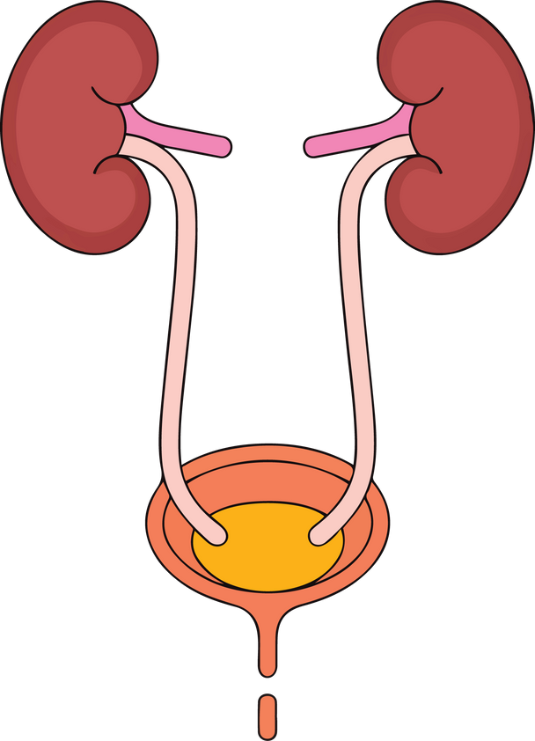
K
a
n
S
u
r
v
i
v
e
Common Side Effects & Symptom Burden
2
.
0
Urinary Symptoms
CRC survivors often experience moderate urinary problems after surgery
  In the previously mentioned cohort of 1,215 long-term survivors (>5 years post-diagnosis):
    30% reported urinary problems
  Postoperative urinary retention
    Pelvic nerve injury can cause acute urinary retention; treat promptly
    Refer to urology if retention persists
  Stress & urge incontinence
    More common in CRC survivors
    Screen for urinary incontinence during routine health maintenance
  Radiation-related urinary symptoms
    Pelvic radiation may lead to incontinence, frequency, urgency, dysuria, or hematuria
    Evidence for effective treatments is limited
    Persistent hematuria warrants urology referral
Bailey CE, Tran Cao HS, Hu CY, et al. Functional deficits and symptoms of long-term survivors of colorectal cancer treated by multimodality therapy differ by age at diagnosis. J Gastrointest Surg. 2015;19(1):180–188; discussio 188.
Burgers K, Moore C, Bednash L. Care of the Colorectal Cancer Survivor. Am Fam Physician. 2018 Mar 1;97(5):331-336. PMID: 29671505.
National Comprehensive Cancer Network. NCCN Clinical Practice Guidelines in Oncology: Colon Cancer, Version 5.2025. Published 2025
El-Shami K, Oeffinger KC, Erb NL, et al. American Cancer Society colorectal cancer survivorship care guidelines. CA Cancer J Clin. 2015;65(6):428-455.

Slide 31
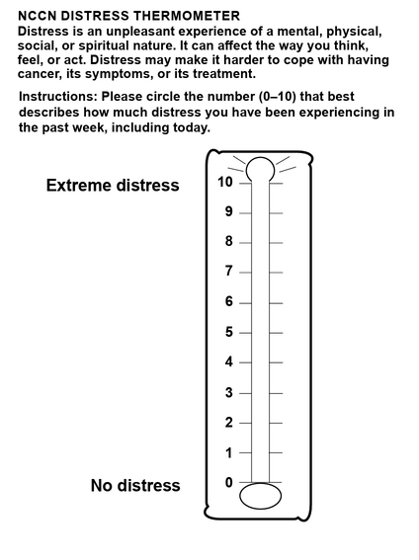
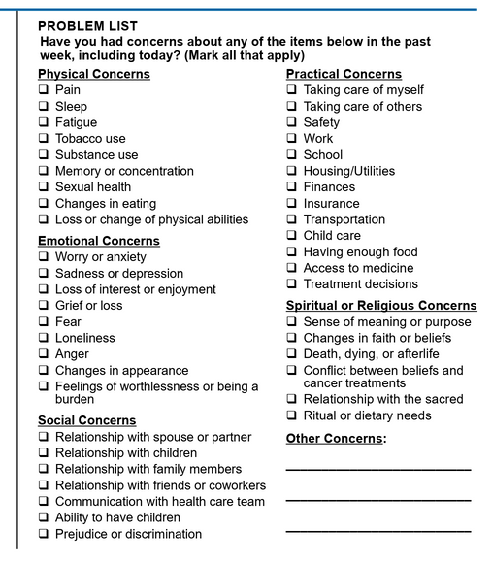
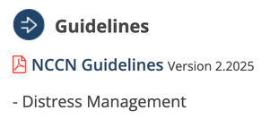
Common Side Effects & Symptom Burden
K
a
n
S
u
r
v
i
v
e
2
.
0
Distress in Cancer Survivorship
“Distress” is the term the NCCN uses to refer to a multifactorial unpleasant experience of psychological (i.e., cognitive, behavioral, emotional) social, spiritual, and/or physical nature that may interfere with one’s ability to cope effectively with cancer its physical symptoms, and treatment.
  Distress should be recognized, monitored, documented, and treated properly at all stages of disease
  Ideally screening would occur at every medical visit
  At a minimum however, screen for distress at the initial visit and appropriate intervals as clinically indicated
  NCCN thermometer + Distress Problem List = quick screener
Mishra SI, Scherer RW, Geigle PM, et al. Exercise interventions on health-related quality of life for cancer survivors. Cochrane Database Syst Rev. 2012(8):CD007566.
Meyerhardt JA, Sato K, Niedzwiecki D, et al. Dietary glycemic load and cancer recurrence and survival in patients with stage III colon cancer: findings from CALGB 89803. J Natl Cancer Inst. 2012;104(22):1702-1711.

Slide 32
K
a
n
S
u
r
v
i
v
e
Common Side Effects & Symptom Burden
2
.
0
Cognitive Symptoms & Stoma Impact
  Cognitive changes after chemotherapy
    Mild, often transient cognitive dysfunction may occur, though mechanisms remain unclear
    Ask about cognitive concerns; consider validated screening tools to guide further evaluation
  Routine symptom screening
    Screen for depression, anxiety, neuropathy, fatigue, and sexual dysfunction
  Stoma-related psychological impact
    Psychological symptoms are more common among patients with colostomies, particularly males or those whose stoma was created after initial surgery
    Despite this, overall quality of life is similar between patients with and without stomas
  Support needs
    Refer patients with stomas to a trained ostomy therapist for specialized care and adjustment support.
Pachler J, Wille-Jørgensen P. Quality of life after rectal resection for cancer, with or without permanent colostomy. Cochrane Database Syst Rev. 2012(12):CD004323.
Burgers K, Moore C, Bednash L. Care of the Colorectal Cancer Survivor. Am Fam Physician. 2018 Mar 1;97(5):331-336. PMID: 29671505.
Cruzado JA, López-Santiago S, Martínez-Marín V, José-Moreno G, Custodio AB, Feliu J. Longitudinal study of cognitive dysfunctions induced by adjuvant chemotherapy in colon cancer patients. Support Care Cancer. 2014;22(7):1815-1823.

Slide 33


K
a
n
S
u
r
v
i
v
e
Common Side Effects & Symptom Burden
2
.
0
Managing Cancer-Related Fatigue
  Common and Long-Lasting
    Fatigue is frequent during treatment and may persist or recur for years afterward
  Screening
    Ask patients to rate fatigue on a 0–10 scale to identify those needing further evaluation
  Effective Interventions
    Support energy conservation strategies
    Encourage regular physical activity
    Integrate mind-body approaches and psychosocial therapy
  Medications & Sleep
    Limited evidence supports stimulant medications for fatigue
    Cognitive behavioral therapy is effective for insomnia
  NCCN Guidelines Version 1.2026
- Cancer-Related Fatigue
Burgers K, Moore C, Bednash L. Care of the Colorectal Cancer Survivor. Am Fam Physician. 2018 Mar 1;97(5):331-336. PMID: 29671505.

Slide 34
K
a
n
S
u
r
v
i
v
e
Common Side Effects & Symptom Burden
2
.
0
Neuropathy, Pain, and Pelvic Fracture
  Chemotherapy-related neuropathy
    Oxaliplatin and other platinum agents can cause neuropathic pain
    Use a validated neuropathy screening tool for patients treated with oxaliplatin
    Symptoms often improve over time but may require treatment
  Neuropathy management
    Duloxetine is first-line
      Other options: tricyclic antidepressants, gabapentin, pregabalin, and compounded topical agents
    Physical therapy and referral to pain management should be considered
  Evaluating pain
    New pain, especially right upper-quadrant or pelvic pain, requires evaluation for recurrence
    Chronic pain may result from radiation proctitis, incisional hernia, or other treatment effects
    Manage similar to the general population: analgesics, behavioral strategies, physical activity, and specialty referral
  Pelvic fracture risk after radiation
    Women age ≥ 65 yrs who received pelvic radiation have higher fracture risk (five-year rate 11.2% vs 8.7%)
    Counsel on fall prevention and osteoporosis management, despite limited evidence for specific interventions
Burgers K, Moore C, Bednash L. Care of the Colorectal Cancer Survivor. Am Fam Physician. 2018 Mar 1;97(5):331-336. PMID: 29671505.
Piccolo J, Kolesar JM. Prevention and treatment of chemotherapy-induced peripheral neuropathy. Am J Health Syst Pharm. 2014;71(1):19-25.
Baxter NN, Habermann EB, Tepper JE, Durham SB, Virnig BA. Risk of pelvic fractures in older women following pelvic irradiation. JAMA. 2005;294(20):2587-2593.

Slide 35
K
a
n
S
u
r
v
i
v
e
Common Side Effects & Symptom Burden
2
.
0
Sexual Dysfunction
  Women
    More than half experience dyspareunia or vaginal dryness after treatment
    Vaginal dryness is more common among women with stomas
    Pelvic floor physical therapy shows benefit in small studies
  Men
    Surgery & radiation for rectal cancer double the risk of erectile & ejaculatory dysfunction
    Ask men treated with radiation / oxaliplatin about symptoms of hypogonadism; treat with testosterone when appropriate
    Phosphodiesterase-5 inhibitors are first-line therapy for erectile dysfunction
Burgers K, Moore C, Bednash L. Care of the Colorectal Cancer Survivor. Am Fam Physician. 2018 Mar 1;97(5):331-336. PMID: 29671505.
Den Oudsten BL, Traa MJ, Thong MS, et al. Higher prevalence of sexual dysfunction in colon and rectal cancer survivors compared with the normative population: a population-based study. Eur J Cancer. 2012;48(17):3161-3170.

Slide 36
K
a
n
S
u
r
v
i
v
e
Common Side Effects & Symptom Burden
2
.
0
Sexual Health in CRC Survivors (2 yrs Post-Diagnosis)
Study Overview
  487 CRC patients (258 men, 229 women); 77% colon cancer, 23% rectal cancer
  Sexual health assessed using Relationship and Sexuality Scale
Key Findings
  54% reported decreased sexual desire
  61% decreased frequency of intercourse
  48% decreased ability to reach orgasm
  Fecal incontinence was linked to declines in all sexual health domains
Rectal vs. Colon Cancer Differences: rectal cancer survivors had significantly more desire and orgasm difficulties than colon cancer survivors
Traa MJ, De Vries J, Roukema JA, Den Oudsten BL (2012) Sexual (dys)function and the quality of sexual life in patients with colorectal cancer: a systematic review. Ann Oncol 23 (1):19-27. https://doi.org/10.1093/annonc/mdr133

Slide 37
K
a
n
S
u
r
v
i
v
e
Common Side Effects & Symptom Burden
2
.
0
Sexual Health in CRC Survivors (2 yrs Post-Diagnosis)
Communication Gaps
  Few survivors discuss sexuality with clinicians:
    20% of men and 11% of women
    11% of colon cancer vs. 33% of rectal cancer patients
Factors increasing discussion: younger age, ostomy, receipt of radiotherapy
Clinical Implications
  Screen for sexual dysfunction - especially for survivors with fecal incontinence
  Don’t assume a conversation about sexuality is “irrelevant” for certain patients due to their age, gender, or relationship status
Traa MJ, De Vries J, Roukema JA, Den Oudsten BL (2012) Sexual (dys)function and the quality of sexual life in patients with colorectal cancer: a systematic review. Ann Oncol 23 (1):19-27. https://doi.org/10.1093/annonc/mdr133
Bober SL, Varela VS. Sexuality in adult cancer survivors: challenges and intervention. J Clin Oncol 2012;30:3712-9

Slide 38


K
a
n
S
u
r
v
i
v
e
Primary Care Actions
2
.
0
Health Promotion & Prevention in CRC Survivors
Vitamin D
  Epidemiological studies suggest Vitamin D deficiency increases the incidence of CRC and has a negative impact on survival, however further research is needed to clarify the role of Vitamin D in CRC
Aspirin
  Evidence is unclear whether aspirin reduces the risk of CRC incidence or mortality when employed as primary prevention
  Daily low-dose aspirin may reduce mortality in stage I–III survivors
    Consider for those with ≥10-year life expectancy and no contraindications
Bains SJ, et. al, Aspirin As Secondary Prevention in Patients With Colorectal Cancer: An Unselected Population-Based Study. J Clin Oncol. 2016 Jul 20;34(21):2501-8. doi: 10.1200/JCO.2015.65.3519. Epub 2016 May 31. PMID: 27247217.
Evertine Wesselink, et. al, Sufficient 25-Hydroxyvitamin D Levels 2 Years after Colorectal Cancer Diagnosis are Associated with a Lower Risk of All-cause Mortality. Cancer Epidemiol Biomarkers Prev 1 April 2021; 30 (4): 765–773. https://doi.org/10.1158/1055-9965.EPI-20-1388
Na SY, Kim KB, Lim YJ, Song HJ. Vitamin D and Colorectal Cancer: Current Perspectives and Future Directions. J Cancer Prev. 2022 Sep 30;27(3):147-156. doi: 10.15430/JCP.2022.27.3.147. PMID: 36258716; PMCID: PMC9537583.

Slide 39


K
a
n
S
u
r
v
i
v
e
Primary Care Actions
2
.
0
Health Promotion & Prevention in CRC Survivors
  Cancer Screening
    Follow standard average-risk screening guidelines for other cancers
    Discuss risks, benefits, and limitations based on individual health status
  Obesity Management
    Obesity increases CRC recurrence risk; encourage evidence-based weight-loss strategies (we can help with this!)
    Encourage patients to aim for 150 minutes/week of physical activity
  Nutrition
    Western diets high in refined grains and sugar increase recurrence risk
    Counsel on nutrition’s role in recurrence prevention
Our team is preparing a webinar on Obesity Management for you! Stay tuned!

Slide 40

K
a
n
S
u
r
v
i
v
e
Primary Care Actions
2
.
0
In Summary...
  Document diagnosis in Problem List, treatment(s) received, current therapy status
  Immunizations - influenza, herpes zoster, pneumococcal, COVID, hepatitis
  Encourage & counsel on movement and good nutrition
  Screen for late/long-term effects (including distress & sexual health!)
  Encourage earlier diagnostic evaluation for persistent GI symptoms in younger adults.
  Support CRC screening awareness and participation beginning at age 45 (per USPSTF & ACS guidelines)
Long-term follow-up, health maintenance, and lifestyle modifications remain important components of the care of CRC survivors.

Slide 41
K
a
n
S
u
r
v
i
v
e
2
.
0
Q&A
QUESTIONS?

Slide 42

K
a
n
S
u
r
v
i
v
e
Case Study
2
.
0
Privacy
Please only display or say information that does not identify a patient or that can not be linked to a patient.​
​
Photos used in Case Study slides are freely-usable images and not actual photos of known patients.

Slide 43

K
a
n
S
u
r
v
i
v
e
CRC Survivorship Case Study: Mary’s Story
2
.
0
Patient Profile
  Name: Mary T.
  Age: 62
  History: Stage II colon cancer diagnosed 4 years ago; treated with colectomy and adjuvant chemotherapy
  Current Status: NED; followed annually by her PCP after completing oncology-directed surveillance
  Comorbidities: Hypertension, obesity (BMI 33), mild peripheral neuropathy from prior chemo
Visit Reason
  Routine chronic disease follow-up.
Key Symptoms and Concerns
  Intermittent abdominal cramping and changes in bowel habits
  Persistent fatigue
  Anxiety about recurrence, especially since a cousin was recently diagnosed with colon cancer
  No documented family history updates in the EHR since her initial cancer diagnosis
Mary

Slide 44
K
a
n
S
u
r
v
i
v
e
CRC Survivorship Case Study: Mary’s Story
2
.
0
During the visit, Mary casually mentions that:
  Her younger brother (age 53) recently had a large adenomatous polyp removed
  That’s when she also learned a maternal aunt was diagnosed with CRC in her early 50's
  Her son (age 35 and also a patient of yours) has never been screened
These details were not in the EHR, and the original family history is now 6 years outdated.
Implications of missing updates:
  Mary meets criteria for genetic risk evaluation, which was never triggered in the EHR
  First-degree relatives may qualify for earlier and more frequent screening, but no alerts are active
  Care team lacks accurate risk stratification to guide survivorship follow-up and counseling
  Missed opportunity to identify a high-risk family
Mary

Slide 45
K
a
n
S
u
r
v
i
v
e
CRC Survivorship Case Study: Mary’s Story
2
.
0
Why Family History Documentation Matters in CRC Survivorship
  Risk evolves over time as relatives age and are diagnosed
  Updated family history can change both patient management & screening recommendations for relatives
  Accurate data helps the clinic meet quality metrics tied to preventive care
  In rural settings with limited genetics access, the EHR must function as the first signal for referrals or enhanced screening
Mary

Slide 46
K
a
n
S
u
r
v
i
v
e
CRC Survivorship Case Study: Practical Strategy
2
.
0
“Annual Family History Refresh” Protocol
A low-burden process the team can maintain.
  Trigger point:
    Add a standard question to the annual wellness visit and chronic disease visits: “Has anyone in your family been diagnosed with cancer or polyps since your last visit?”
  Team-based entry:
    MA/RN documents new information directly in the structured family history section before the PCP enters the room
    PCP reviews and confirms accuracy
  EHR Optimization:
    Create a dotphrase or quick-text template for consistent documentation
    Enable automatic alerts for early-onset cancers, multiple colorectal cancers, or advanced adenomas in first-degree relatives
  Closing the loop:
    PCP briefly counsels the patient on what this means for their own risk
    Provide a take-home message encouraging them to share screening guidance with relatives
    Refer to genetics if criteria are met, or flag for the practice facilitator/EHR optimization lead to review

Slide 47
K
a
n
S
u
r
v
i
v
e
DOCUMENTING ATTENDANCE
2
.
0
Take a photo of this slide or write down the code. It will not be released after session ends.
57tets (five seven T E T S)
NOTE: The deadline to enter the sign-in code is November 19, 2025 @ 5:00 PM
You may enter the sign-in code to complete the course evaluation by:
Text the activity identification code to (828) 295-1144, OR
Access www.eeds.com from a mobile device or PC and enter the activity identification code, OR
Download the eeds mobile app (iOS, Android) and use the activity identification code to sign-in to events, OR
Scan the QR code on the left.
kansurvive.com
Once your attendance is confirmed via the Zoom Roster, and that you have met all attendance requirements, you will receive an e-mail that your certificate is available 7-10 business days post event.
Continuing Education provided by KU Area Health Education Center | www.kumc.edu/ahec | checkahec@kumc.edu

Slide 48
K
a
n
S
u
r
v
i
v
e
2
.
0
THANK YOU
kansurvive.com

