Slide 1












K
a
n
S
u
r
v
i
v
e
2
.
0
Testing Enhanced Models of Cancer Survivorship Care for Rural Cancer Survivors in Primary Care Practice
Breast Cancer Survivorship in Rural Primary Care
kansurvive.com
Guest Speaker
Anne O’Dea, MD

Slide 2
K
a
n
S
u
r
v
i
v
e
Introduction
2
.
0
Why Cancer Survivorship Care Matters
  Cancer survivorship is growing due to early detection & treatment.
  Most cancer survivors living today were diagnosed more than 5 years ago and have transitioned from oncological to primary care settings.
  Cancer survivors are at greater risk for cardiovascular disease, depression, and secondary cancers (conditions routinely managed in primary care) than the general population.
  Rural cancer survivors face unique barriers: distance, limited specialists, fewer support services.
M. Charlton, et al. Challenges of Rural Cancer Care in the United StatesOncology (Williston Park) 2015 Vol. 29 Issue 9 Pages 633-40. Accession Number: 26384798. https://www.ncbi.nlm.nih.gov/pubmed/26384798
X. Shen X., et al., Differences in Rural Versus Urban Patients With Prostate Cancer in Diagnosis and Treatment: An Analysis of a Population-Based Cohort
JCO Oncol Pract. 2024, Accession Number: 38739876 DOI: 10.1200/OP.23.00547. https://www.ncbi.nlm.nih.gov/pubmed/38739876

Slide 3
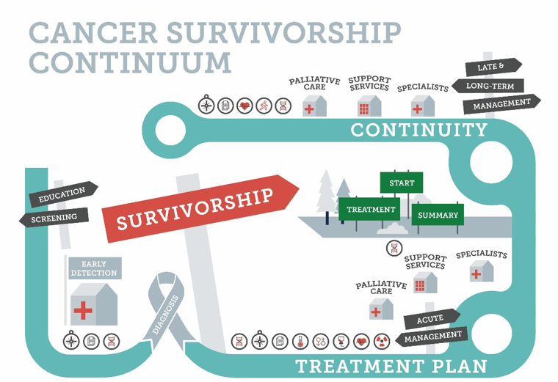
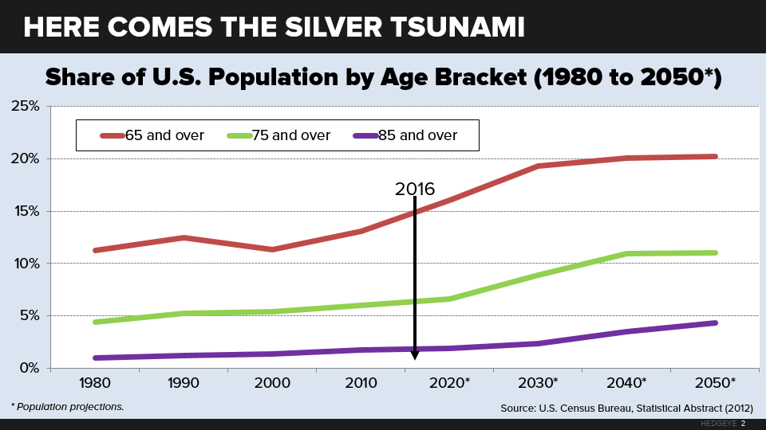



K
a
n
S
u
r
v
i
v
e
Introduction
2
.
0
Cancer Survivorship & the Silver Tsunami

Slide 4

K
a
n
S
u
r
v
i
v
e
2
.
0
The Role of Primary Care
  Most cancer survivors are seen exclusively in primary care
  Primary care providers (PCPs) are well-positioned to:
    Provide coordinated care
    Address comorbidities
    Monitor for recurrence and late effects
    Promote healthy behaviors
  Survivorship care (for many survivors) is a natural extension of chronic disease management
Introduction
A. Singh A. et.al, Care Models for Cancer Survivors. Annu Rev Med 2025 Vol. 76 Issue 1 Pages 225-241. Accession Number: 39661552 DOI: 10.1146/annurev-med-042423-044004. https://www.ncbi.nlm.nih.gov/pubmed/39661552

Slide 5
K
a
n
S
u
r
v
i
v
e
2
.
0
Barriers to Delivering Guideline-Based Survivorship Care
  Limited formal training in survivorship care
  Gaps in communication between oncology and primary care
  Lack of survivorship care plans or clear documentation in electronic health records (EHRs)
  Time constraints, competing demands
It's Not Always Easy: Cancer Survivorship Care in Primary Care Settings
M. Becevic, A. B. Anbari and J. A. McElroy; J Cancer Educ 2023 . DOI: 10.1007/s13187-023-02304-w. https://www.ncbi.nlm.nih.gov/pubmed/37133797
Introduction
Vos, JAM, et al. Primary care physicians' knowledge and confidence in providing cancer survivorship care: a systematic review
. J Cancer Surviv 2023. DOI: 10.1007/s11764-023-01397-y. https://www.ncbi.nlm.nih.gov/pubmed/37171716

Slide 6

K
a
n
S
u
r
v
i
v
e
2
.
0
What This Session Will Cover
  Overview of BC survivorship care guidelines (NCCN, ASCO, USPSTF)
  Key late and long-term effects for breast cancer (BC)
  Practical tools, resources and workflows for primary care
  A case example and clinical documentation tips
Introduction

Slide 7
Learning Objectives
K
a
n
S
u
r
v
i
v
e
2
.
0
Learning Objectives
By the end of this session, participants will be able to:
  Describe the core components of BC survivorship care
  Recognize common long-term and late effects of BC treatment
  Apply BC survivorship care guidelines to routine primary care
  Use tools and documentation strategies to support BC survivors

Slide 8
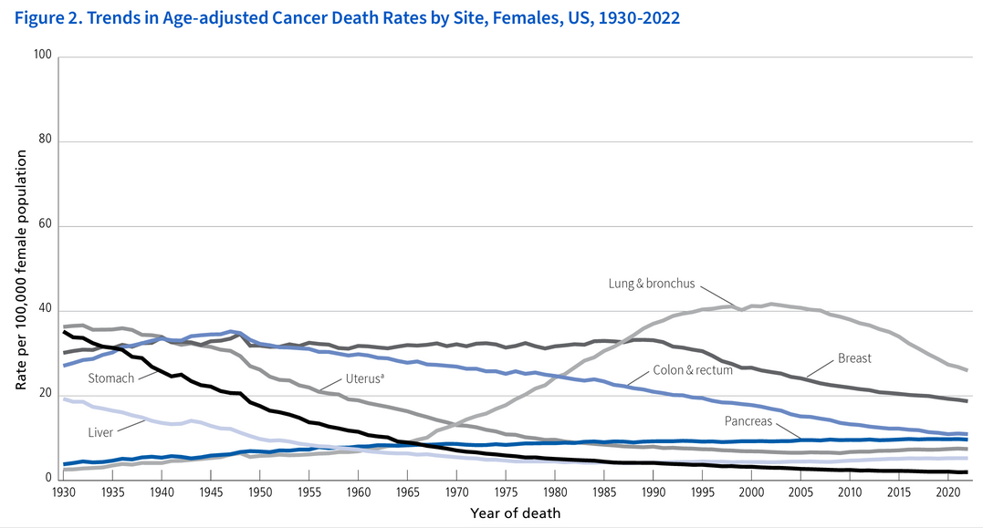



Background
K
a
n
S
u
r
v
i
v
e
2
.
0
Breast Cancer Incidence
  Most common among women
  ~297,000 new cases of invasive BC in 2025
1 in 8 women will develop BC in her lifetime
American Cancer Society. Cancer Facts & Figures 2025. Atlanta: American Cancer Society; 2025.

Slide 9
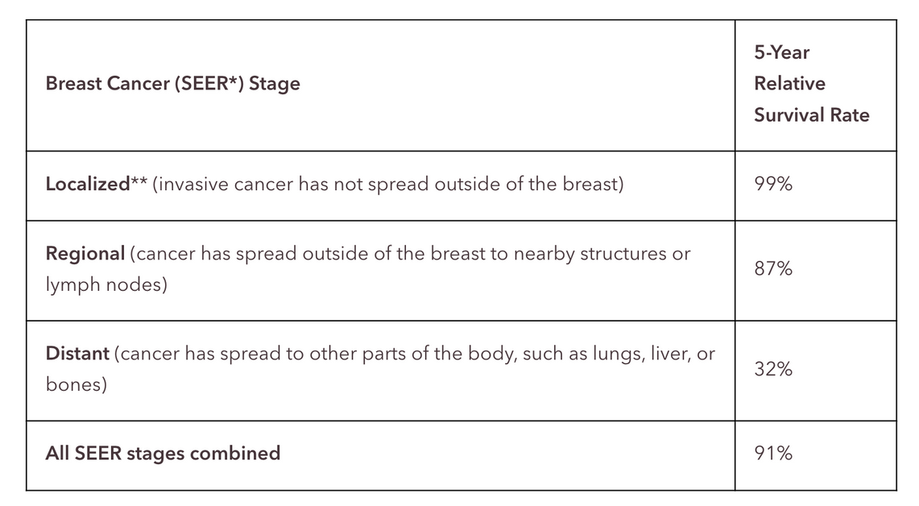
Background
K
a
n
S
u
r
v
i
v
e
2
.
0
Breast Cancer Mortality
  BC is the second leading cause of cancer death in U.S. women, behind lung cancer
  In 2025, an estimated 42,170 women will die from breast cancer in the U.S.
  The chance that a woman will die from breast cancer is 1 in 39, or about 2.5%
SEER is the Surveillance, Epidemiology, and End Results database, maintained by the National Cancer Institute (NCI).
**Localized stage only includes invasive cancer. It does not include ductal carcinoma in situ (DCIS).
Chart source: American Cancer Society
American Cancer Society. Cancer Facts & Figures 2025. Atlanta: American Cancer Society; 2025.

Slide 10
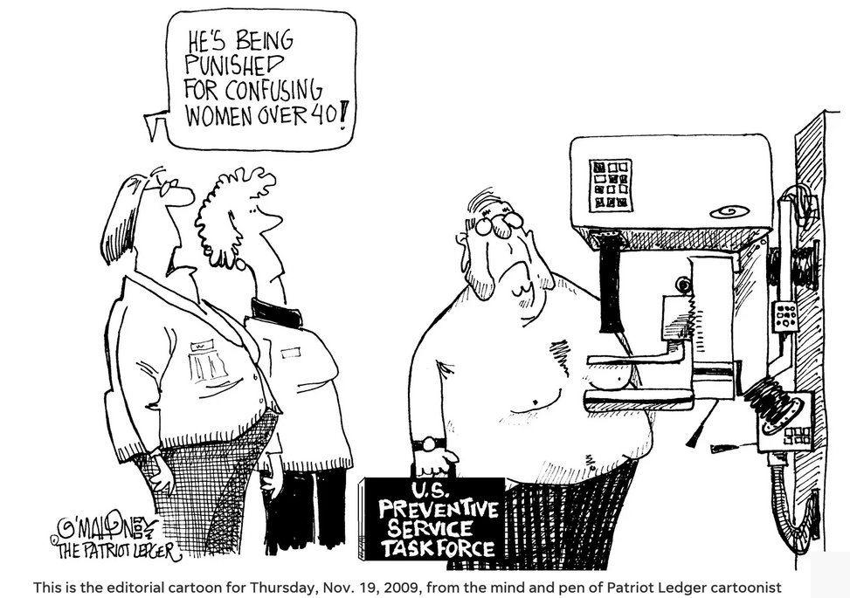




Screening
K
a
n
S
u
r
v
i
v
e
2
.
0
Breast Cancer Prevention & Screening
There are lots of guidelines...
Keep it simple...
  Begin routine screening at age 40
  Review family history of cancer
  Conduct a risk assessment
    Women at high-risk for BC may need an annual MRI + mammogram
Saccarelli CR, Bitencourt AGV, Morris EA. Breast Cancer Screening in High-Risk Women: Is MRI Alone Enough? J Natl Cancer Inst. 2020 Feb 1;112(2):121-122. doi: 10.1093/jnci/djz130. PMID: 31233125; PMCID: PMC7019094.

Slide 11


Diagnosis & Treatment
K
a
n
S
u
r
v
i
v
e
2
.
0
How We Diagnosis Breast Cancer
  Detected by screening mammogram, diagnostic imaging, and biopsy
  Staging determines extent: local, regional, metastatic
  Tumor subtyping (ER/PR, HER2) guides treatment decisions
How We Treat Breast Cancer
  Surgery: lumpectomy or mastectomy ± reconstruction.
  Radiation: post-lumpectomy or select mastectomy cases
  Chemotherapy: systemic therapy for higher-risk disease
  Endocrine therapy: tamoxifen or aromatase inhibitors (5–10 yrs for ER+)
  Targeted therapy: trastuzumab for HER2+, CDK4/6 inhibitors, PARP inhibitors
  Immunotherapy: emerging use for triple-negative cancers
NCCN Guidelines Version 4.2025 - Breast Cancer

Slide 12

Survivorship
K
a
n
S
u
r
v
i
v
e
2
.
0
Breast Cancer Survivorship
  Over 4 million BC survivors currently living in the U.S.
  Most survivors transition back to primary care after active treatment
  BC survivorship can span decades, with persistent or late-onset effects
  Type of treatment influences late effects
    (e.g., lymphedema, cardiotoxicity, bone loss)
  PCPs should know treatment history to guide follow-up care
American Cancer Society. Cancer Facts & Figures 2025. Atlanta: American Cancer Society; 2025.

Slide 13
Transition to Primary Care
K
a
n
S
u
r
v
i
v
e
2
.
0
Breast Cancer Survivorship
  Survivorship care often shifts from oncology to PCPs within 5 years
  PCP responsibilities:
    Monitor for recurrence
    Manage late & long-term effects
    Coordinate care & comorbidities
    Survivorship Care Plans (SCPs) may be missing; PCPs may need to adapt
B. D. Hayes B.D. et al., Optimizing the integration of family physicians into cancer survivorship care in the BC Interior: a mixed methods study of physicians' opinions and experience. J Cancer Surviv 2025 . Accession Number: 39904938 DOI: 10.1007/s11764-025-01751-2. https://www.ncbi.nlm.nih.gov/pubmed/39904938
Radhakrishnan A, et al. Oncology and primary care involvement in breast cancer survivorship care more than 5 years after initial treatment; JCO Oncol Pract 2024. DOI: 10.1200/OP-24-00620
https://www.ncbi.nlm.nih.gov/pubmed/39642316

Slide 14
Surveillance for Recurrence
K
a
n
S
u
r
v
i
v
e
2
.
0
What is recommended and not...
  Annual, digital mammography (on preserved breast tissue)
  Watch for: bone pain, neurologic symptoms, respiratory issues, unexplained weight loss
  Routine imaging/tumor markers not recommended without symptoms and based on patient’s risk
NCCN Guidelines Version 4.2025 - Breast Cancer

Slide 15



Late & Long-Term Side Effects
K
a
n
S
u
r
v
i
v
e
2
.
0
Physical
Endocrine & Bone
  Arthralgias
  Neuropathy
  Lymphedema
  Menopause
  Sleep / fatigue
  Osteopenia / osteoporosis
  Weight gain
  Vasomotor symptoms
Cardiac
Psychosocial
  Anthracyclines
  Radiation therapy
  Body image
  Sexual dysfunction
  Fear of recurrence
  Distress

Slide 16
Late & Long-Term Side Effects
K
a
n
S
u
r
v
i
v
e
2
.
0
Surgery & Radiation
  Surgery
    Lymphedema
    Shoulder mobility issues
    Neuropathic pain
  Radiation
    Skin changes, fibrosis
    Pulmonary fibrosis
    Increased cardiac risk (esp. left-sided)
NCCN Guidelines Version 4.2025 - Breast Cancer

Slide 17
Late & Long-Term Side Effects
K
a
n
S
u
r
v
i
v
e
2
.
0
Lymphedema
Approximately 1 in 5 patients following BC treatment will develop lymphedema.
  3-8% with sentinel lymph node surgery
  11% with radiation therapy
  23% with axillary lymph node dissection
    Typically presents in the first 3 yrs post-treatment in 75% of patients, but can present anytime
  Overweight / obesity is a risk factor
  Lymphedema prevention: IV blood draws, BP cuffs, exercise, flying
    Encourage patients to maintain range of motion and strength training in their upper extremity
DiSipio T, Rye S, Hayes S. Incidence of unilateral arm lymphoedema after breast cancer: a systematic review and meta-analysis. Lancet Oncol. 2014;14(6):500-515. doi:10.1016/S1470-2045(13)70076-7
Gillespie TC, et al. Breast cancer-related lymphedema: Risk factors, precautionary measures, and treatments. Gland Surg. 2018;7(4):379-403. doi:10.21037/gs.2017.11.04
Fu MR. Breast cancer-related lymphedema: Symptoms, diagnosis, risk reduction, and Management. World J Clin Oncol. 2014;5(3):241-247. doi:10.5306/wjco.v5.i3.241

Slide 18
Late & Long-Term Side Effects
K
a
n
S
u
r
v
i
v
e
2
.
0
Chemo & Endocrine Therapy
  Chemotherapy
    Neuropathy
    Cardiotoxicity (anthracyclines, HER2 therapy)
    Cognitive changes (“chemo brain”)
  Endocrine Therapy
    Tamoxifen: ↑ risk VTE, endometrial cancer, menopausal symptoms
    Aromatase inhibitors: bone loss, arthralgia, cardiovascular risk
NCCN Guidelines Version 4.2025 - Breast Cancer

Slide 19
Late & Long-Term Side Effects
K
a
n
S
u
r
v
i
v
e
2
.
0
Cardiotoxicity
  Left Chest Radiation therapy
    Small risk of CVD appearing 10-15 years post-treatment
  HER2-targeted therapy (trastuzumab)
    ~3-18% incidence of cardiac dysfunction
  Anthracyclines
    ~5% incidence of symptomatic heart failure
Kidane, RD, et. al, Cardiovascular Health Considerations for Primary Care Physicians Treating Breast Cancer Survivors Mayo Clin Proc 2025 Vol. 100 Issue 1 Pgs 124-140 DOI: 10.1016/j.mayocp.2024.08.014. https://www.ncbi.nlm.nih.gov/pubmed/39641716

Slide 20
Late & Long-Term Side Effects
K
a
n
S
u
r
v
i
v
e
2
.
0
Cardiotoxicity
  Survivorship Monitoring
    Initial cardiac assessment 6-12 months post-treatment
    Repeat every 6 months for 2 years after systemic therapy
  Risk Reduction Counseling
    Smoking cessation
    Diabetes, dyslipidemia, & HTN control
NCCN Guidelines Version 2.2025. Cancer Survivorship
NCCN Guidelines Version 4.2025 - Breast Cancer
Wong J, Soh CH, Wang B, Marwick T. Long-term risk of heart failure in adult cancer survivors: a systematic review and meta-analysis. Heart. 2024 Sep 16;110(19):1188-1195. doi: 10.1136/heartjnl-2024-324301. PMID: 39174318; PMCID: PMC11420760.

Slide 21

Late & Long-Term Side Effects
K
a
n
S
u
r
v
i
v
e
2
.
0
Immunotherapy
Emerging Role
  Immunotherapy (e.g., checkpoint inhibitors, PARP inhibitors, investigational CAR-T) increasingly used in triple-negative and advanced breast cancer
Survivorship implications
    Growing number of survivors previously exposed to immunotherapy
Unique Challenge
  Side effects can appear during treatment, soon after, or years later
  Requires long-term monitoring beyond traditional 5-year follow-up
· NCCN Guidelines Version 1.2025
- CAR T-Cell-Related Toxicities
- Immune Checkpoint Inhibitor-Related Toxicities
- Lymphocyte Engager-Related Toxicities

Slide 22
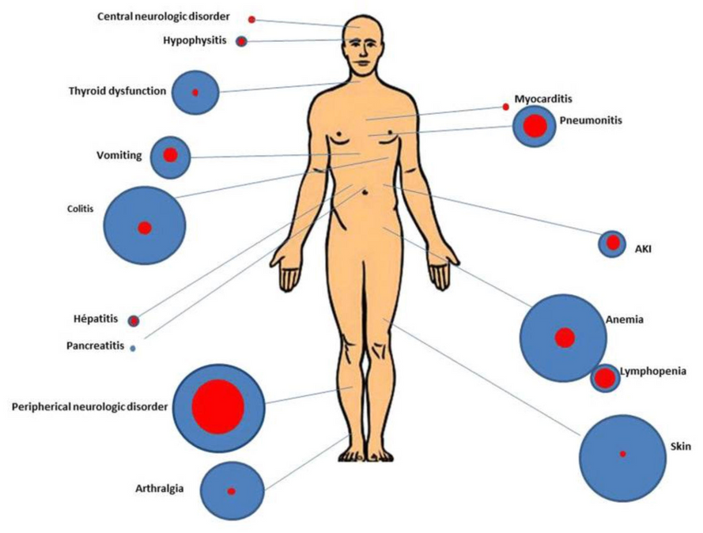
Late & Long-Term Side Effects
K
a
n
S
u
r
v
i
v
e
2
.
0
Immunotherapy: Systems Affected
Endocrine
  hypothyroidism, adrenal insufficiency, diabetes
Dermatologic
  rash, vitiligo, pruritus
GI / Hepatic
  colitis, hepatitis
Pulmonary
  pneumonitis
Cardiac
  myocarditis, pericarditis (rare but serious)
PD-1/PD-L1 targeted checkpoint inhibitors can affect many parts of the body. Circle size represents side effect incidence; blue color is any side effect, red is severe toxicity.
Credit: Ann Intensive Care. Feb. 2019. doi: 10.1186/s13613-019-0487-x. Creative Commons 4.0.

Slide 23
Late & Long-Term Side Effects
K
a
n
S
u
r
v
i
v
e
2
.
0
Managing Immune-Related Late Effects
Monitoring
  Extended follow-up for delayed immune-related adverse events (irAEs)
  Screen endocrine, pulmonary, cardiac, and GI systems regularly
Management
  May require steroids or immunosuppressants long after active treatment.
Collaboration is Essential
  oncology, primary care, endocrinology, cardiology
· NCCN Guidelines Version 1.2025
- CAR T-Cell-Related Toxicities
- Immune Checkpoint Inhibitor-Related Toxicities
- Lymphocyte Engager-Related Toxicities

Slide 24
Late & Long-Term Side Effects
K
a
n
S
u
r
v
i
v
e
2
.
0
Managing Immune-Related Late Effects
Quality of Life
  Chronic fatigue, pain, or mood changes may persist
  Importance of mental health support & patient education on self-monitoring
Current survivorship guidelines
  Rarely address late immunotherapy effects in BC
NCCN Guidelines Version 1.2025
- CAR T-Cell-Related Toxicities
- Immune Checkpoint Inhibitor-Related Toxicities
- Lymphocyte Engager-Related Toxicities

Slide 25
Risk Reduction & Health Promotion
K
a
n
S
u
r
v
i
v
e
2
.
0
Keep doing these things!
  Encourage exercise & healthy weight
  Limit alcohol (≥3 drinks/week increases recurrence risk).
  Support smoking cessation
  Maintain routine preventive care & vaccinations
    Gynecology visits recommended annually for:
      Women taking endocrine therapy (e.g., tamoxifen) with an intact uterus
      If post-menopausal, any vaginal bleeding is abnormal
      1-2% of women taking tamoxifen develop endometrial cancer

Slide 26
Bone Health
K
a
n
S
u
r
v
i
v
e
2
.
0
Keep doing these things!
  Bone Health Management for BC survivors on AI
    Baseline DEXA scan for all patients starting endocrine therapy with an AI
    Repeat DEXA scan every 2 years to monitor for osteopenia/osteoporosis
  Vitamin D and Calcium Supplementation
    If <30 ng/mL, initiate vitamin D supplementation
    Recommend daily intake (Calcium 1200 mg & Vitamin D3: 1000 IU)
  Medications for Bone Health
    Bisphosphonates (e.g., zoledronic acid, denosumab) for prevention & treatment
    Before initiating bisphosphonates conduct baseline dental evaluation to minimize risk of osteonecrosis of the jaw (rare, <1%)

Slide 27
Psychosocial & Quality of Life
K
a
n
S
u
r
v
i
v
e
2
.
0
How does your practice screen for & address...
  Fear of recurrence
  Depression, anxiety
  Body image & sexual health concerns
  Sleep disturbances & fatigue (30% of survivors)
  Cognitive changes
NCCN Guidelines Version 2.2025. Cancer-Related Fatigue
NCCN Guidelines Version 2.2025. Distress Management

Slide 28
Fertility & Sexual Health
K
a
n
S
u
r
v
i
v
e
2
.
0
How does your practice screen for & address...
  Address vaginal dryness, dyspareunia, libido.
  Prefer non-hormonal interventions
  Topical estrogen: careful case-by-case discussion
  Fertility counseling for younger survivors
Rodrigues-Machado N, Bonfill-Cosp X, Quintana MJ, Santero M, Bártolo A, Olid AS. Sexual dysfunction in women with breast cancer: a systematic review. Support Care Cancer. 2025 Mar 31;33(4):332. doi: 10.1007/s00520-025-09352-6. PMID: 40163251; PMCID: PMC11958476.

Slide 29

Genetic & Family Risk
K
a
n
S
u
r
v
i
v
e
2
.
0
How are you using Family History as a risk assessment tool?
  5–10% of breast cancers are hereditary
  Regularly update family history
  Refer for genetic counseling/testing when indicated
  Consider cascade testing for relatives
NCCN Guidelines Version 1.2026
Genetic/Familial High-Risk Assessment: Breast, Ovarian, Pancreatic, and Prostate

Slide 30

K
a
n
S
u
r
v
i
v
e
Case Study
2
.
0
Privacy
Please only display or say information that does not identify a patient or that can not be linked to a patient.​
​
Photos used in Case Study slides are freely-usable images and not actual photos of known patients.

Slide 31

BC Survivorship Case Study: Mary’s Story
K
a
n
S
u
r
v
i
v
e
2
.
0
  Mary, 62, presents for her Annual Wellness Visit
  Long-term patient of yours
  PMH: Hypertension, Type 2 Diabetes, BMI 33
  “Breast cancer (history)” appears in problem list; no other treatment details
  Family history: Mother, ovarian cancer (58), Sister, BC (45)
Mary

Slide 32

BC Survivorship Case Study: Mary’s Story
K
a
n
S
u
r
v
i
v
e
2
.
0
Why Treatment History Matters
Mary informs you that she had...
  Left breast cancer about 7 years ago
  A lumpectomy, sentinel node biopsy
  Adjuvant radiation therapy
  5 years of tamoxifen (completed 2 years ago)
Mary
What key survivorship considerations come to mind?

Slide 33
BC Survivorship Case Study: Mary’s Story
K
a
n
S
u
r
v
i
v
e
2
.
0
Key Survivorship Considerations
  Radiation: Late cardiac effects → monitor BP, lipids, diabetes
  Endocrine therapy: Bone health, menopausal symptoms
  Psychosocial health: Anxiety, fatigue, sexual function
  Multiple first-degree relatives w/ breast/ovarian cancer → Possible BRCA1/2 or HBOC syndrome
Mary

Slide 34
Key Takeaways & Practical Strategies
K
a
n
S
u
r
v
i
v
e
2
.
0
Informs surveillance & preventive care
  Update Problem List w/ diagnosis & treatment history
  Ask about survivorship care plan
  Document under chronic care/survivorship codes
  Assign MA/nurse to pre-visit survivorship checklist
  Create a templated well-person visit for cancer survivors
  Add “Family Cancer History” to AWV intake or update yearly
Family / genetic history saves lives across generations
Small workflow changes = big improvement

Slide 35


K
a
n
S
u
r
v
i
v
e
Announcements
2
.
0
How else can KanSurvive 2.0 add value to your practice?
  Cost analysis opportunity for AI / scribe services
  EHR workflow support (e.g., build templates, AI training)
  Identify referral resources for specialties (e.g., lymphedema)
  Training for staff on documenting family history efficiently & effectively
amaldonado2@kumc.edu
cknight2@kumc.edu

Slide 36

Coming up…
K
a
n
S
u
r
v
i
v
e
2
.
0
Data Collection Reminders
Topic: Prostate Cancer Survivorship
Date: Wednesday, October 22nd at Noon
Baseline EHR data – GREAT JOB!
  Deadline: November 30
Practice Characteristics Survey
  Sending out next week
Organizational Readiness Survey
  Sending out at end of October
Guest Speaker:
Richard “Jake” Fantus, MD KUMC urologist & EHR expert

Slide 37
K
a
n
S
u
r
v
i
v
e
2
.
0
THANK YOU!
kansurvive.com

