Slide 1












K
a
n
S
u
r
v
i
v
e
2
.
0
Testing Enhanced Models of Cancer Survivorship Care for Rural Cancer Survivors in Primary Care Practice
Prostate Cancer Survivorship in Rural Primary Care
kansurvive.com
Guest Speaker
Richard “Jake” Fantus, MD

Slide 2

K
a
n
S
u
r
v
i
v
e
AGENDA
2
.
0
Time | Presentation | Presenter
12:00 - 12:05 pm | Welcome & Introductions | Team
12:05 - 12:15 pm | Cancer Survivorship Review | Allen Greiner, MD
12:15 - 12:45 pm | Didactic: Breast Cancer Survivorship | Richard Fantus, MD
12:45 - 12:55 pm | Case Presentation & Discussion | Dr. Fantus & Team
12:55 - 1:00 pm | Wrap-up & Announcements | Team
kansurvive.com

Slide 3


K
a
n
S
u
r
v
i
v
e
RECORDING & TIPS
2
.
0
  Mute yourself when not speaking.​
  Turn your camera on – we would love to see you!​
  Speak up, use the chat box, and actively engage.​
  Visit www.kansurvive.com for session materials.
kansurvive.com
By participating in this ECHO clinic, you are consenting to be recorded.
Recording is for educational and quality improvement purposes.​

Slide 4


K
a
n
S
u
r
v
i
v
e
CONTINUING EDUCATION CREDIT
2
.
0
In support of improving patient care, University of Kansas Medical Center is jointly accredited by the Accreditation Council for Continuing Medical Education (ACCME), the Accreditation Council for Pharmacy Education (ACPE), and the American Nurses Credentialing Center (ANCC), to provide continuing education for the healthcare team.​
Physician: ​
The University of Kansas Medical Center designates this live activity for a maximum of 1 AMA PRA Category 1 Credit™. Physiciansshould claim only the credit commensurate with the extent of their participation in the activity.​
​
Nursing: ​
The University of Kansas Medical Center designates this activity for a maximum of 1 ANCC contact hours. Nurses should claim onlythe credit commensurate with the extent of their participation in the activity.​
​
Certificate of Attendance:​
Certificates of attendance are available to other participants upon completion of documentation of attendance and evaluation asoutlined​
​
Attendance requirement : ​
Participants missing more than 10% of this offering will not receive continuing education credit.​
kansurvive.com

Slide 5
K
a
n
S
u
r
v
i
v
e
DISCLOSURES
2
.
0
kansurvive.com

Slide 6
K
a
n
S
u
r
v
i
v
e
COMMERCIAL / NON-COMMERICAL SUPPORT
2
.
0
There is no commercial support for this CE activity. ​
kansurvive.com

Slide 7
K
a
n
S
u
r
v
i
v
e
FUNDING SOURCE
2
.
0
This project is funded by the National Cancer Institute (U01CA290664-01) with additional support from the University of Kansas Cancer Center (KUCC), Masonic Cancer Alliance (MCA), Kansas Patients and Providers Engaged in Prevention Research (KPPEPR), and Frontiers CTSA .
kansurvive.com

Slide 8


K
a
n
S
u
r
v
i
v
e
For Your Practice
2
.
0
How else (besides improving care for your survivors) can KanSurvive 2.0 add value to your practice?
  Cost analysis opportunity for AI / scribe services
  EHR workflow support (e.g., build templates, AI training)
  Identify referral resources for specialties (e.g., lymphedema)
  Training for staff on documenting family history efficiently & effectively
Araceli Maldonado
Research Assistant
amaldonado2@kumc.edu
Catie Knight
Project Director
cknight2@kumc.edu

Slide 9


K
a
n
S
u
r
v
i
v
e
Learning Objectives
2
.
0
Learning Objectives
By the end of this session, participants will be able to:
  Describe the core components of prostate cancer survivorship care
  Recognize common long-term and late effects of prostate cancer treatment
  Apply prostate cancer survivorship care guidelines to routine primary care
  Use tools and documentation strategies to support prostate cancer survivors

Slide 10

K
a
n
S
u
r
v
i
v
e
2
.
0
Introduction
Why Cancer Survivorship Matters in Rural Primary Care Practice
Nearly two-thirds of cancer survivors are now living 5+ years beyond diagnosis.
  Survivorship care (for many survivors) is a natural extension of chronic disease management.
Most rural survivors receive ongoing care in primary care settings.
Rural primary care providers play a vital role in:
    Monitoring for recurrence
    Managing late and long-term treatment effects
    Addressing psychosocial and preventive care needs
Yet, many clinics lack tailored tools, EHR supports, and resources to deliver evidence-based survivorship care.
A. Singh A. et.al, Care Models for Cancer Survivors. Annu Rev Med 2025 Vol. 76 Issue 1 Pages 225-241. Accession Number: 39661552 DOI: 10.1146/annurev-med-042423-044004. https://www.ncbi.nlm.nih.gov/pubmed/39661552

Slide 11
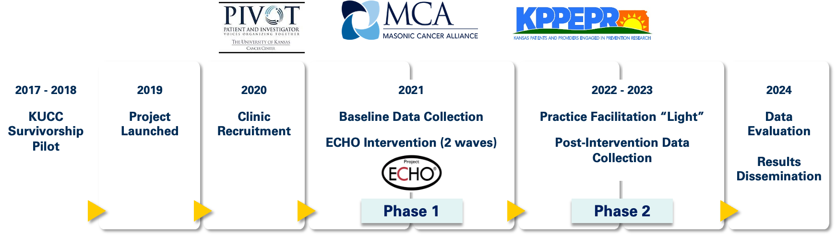
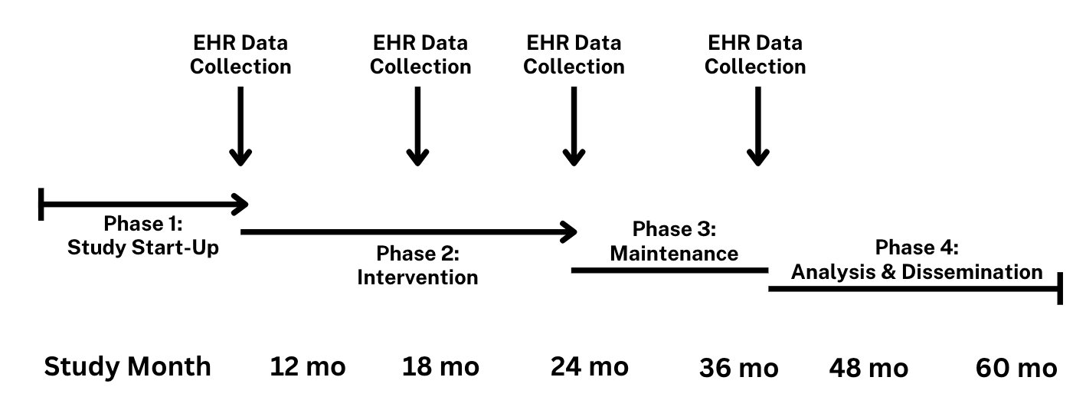
K
a
n
S
u
r
v
i
v
e
The KanSurvive Project Journey
2
.
0
Advancing Survivorship Care through Research
KanSurvive (2019–2023)
  Engaged 12 rural practices in virtual education and practice facilitation.
  Improved provider knowledge and confidence in survivorship care.
KanSurvive 2.0 (2023–2028)
  Expanding to 16 rural primary care clinics.
  Testing implementation strategies (AI and virtual scribes, team-based care) to improve guideline-concordant survivorship care.
ADD PUBS

Slide 12

K
a
n
S
u
r
v
i
v
e
Thank you!
2
.
0
Project Milestones & Announcements
Clinic Engagement
  All Wave 1 sites have completed onboarding and have begun baseline assessments.
Opportunities
Cost analysis pilot
  Research question: How will you measure [AI adoption] success?
Cross-site learning
  Share a success story, case study, idea for QI, to be shared at a future session.
Upcoming Activities
Provider and staff surveys to inform implementation
Continued ECHO education sessions on survivorship
Randomization planned for December

Slide 13
K
a
n
S
u
r
v
i
v
e
2
.
0
Introduction
Our guest speaker today...
Prostate Cancer Survivorship in Rural Primary Care
Guest Speaker
Richard “Jake” Fantus, MD

Slide 14
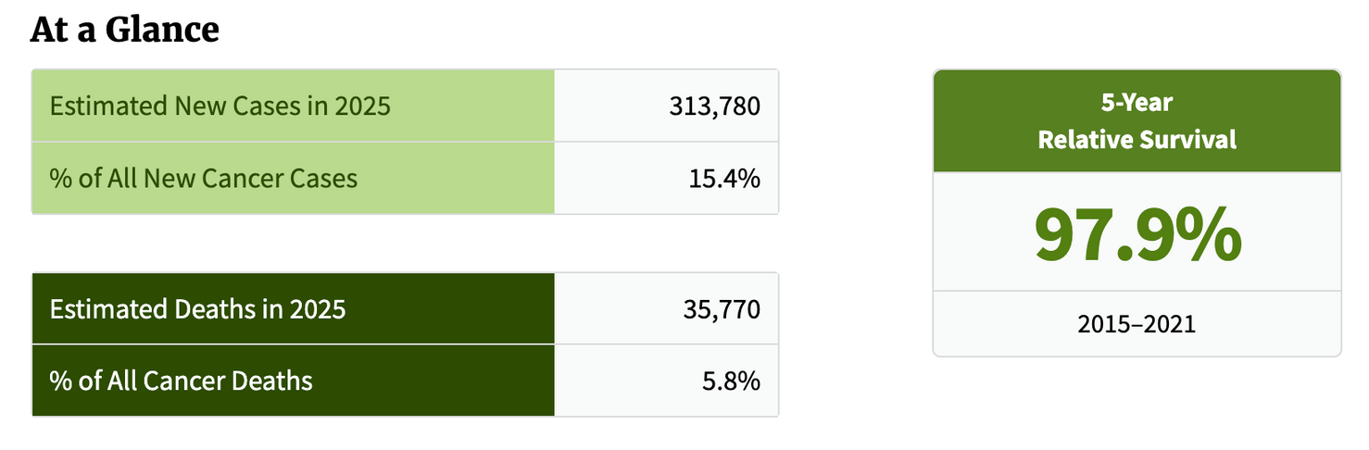
K
a
n
S
u
r
v
i
v
e
Background
2
.
0
Prostate Cancer: Incidence & Mortality
  Most common malignancy in men
  Second most common cause of death in men
    35,000 men will die PC in 2025
    Risk of death tied to stage of presentation
      Localized PC has a 95% cure rate
American Cancer Society. Cancer Facts & Figures 2025. Atlanta: American Cancer Society; 2025.
SEER Cancer Stat Facts: Prostate Cancer: https://seer.cancer.gov/statfacts/html/prost.html

Slide 15
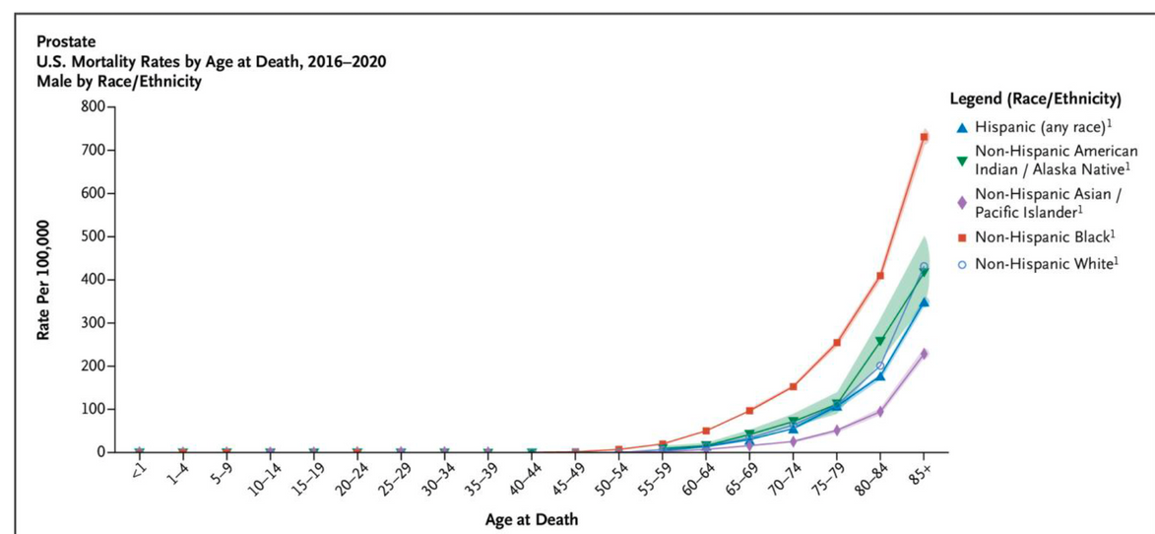
K
a
n
S
u
r
v
i
v
e
Background
2
.
0
Prostate Cancer Risk
  PC risk is multifactorial (age, genetics, race/ethnicity)
  ~ 6 in 10 PCs are diagnosed in men ≥65 yrs
  PC is rare in men ≤ 40
  Average age of men when first diagnosed is ~ 67 yrs
  Black men have a disproportionately higher risk for PC and getting it sooner → greater risk of QALY lost
Lai SM, et al. Variations in Age-Adjusted Prostate Cancer Incidence Rates by Race and Ethnicity After Changes in Prostate-Specific Antigen Screening Recommendation. JAMA Netw Open. 2022 Nov 1;5(11):e2240657. doi: 10.1001/jamanetworkopen.2022.40657. PMID: 36342715; PMCID: PMC9641538.

Slide 16
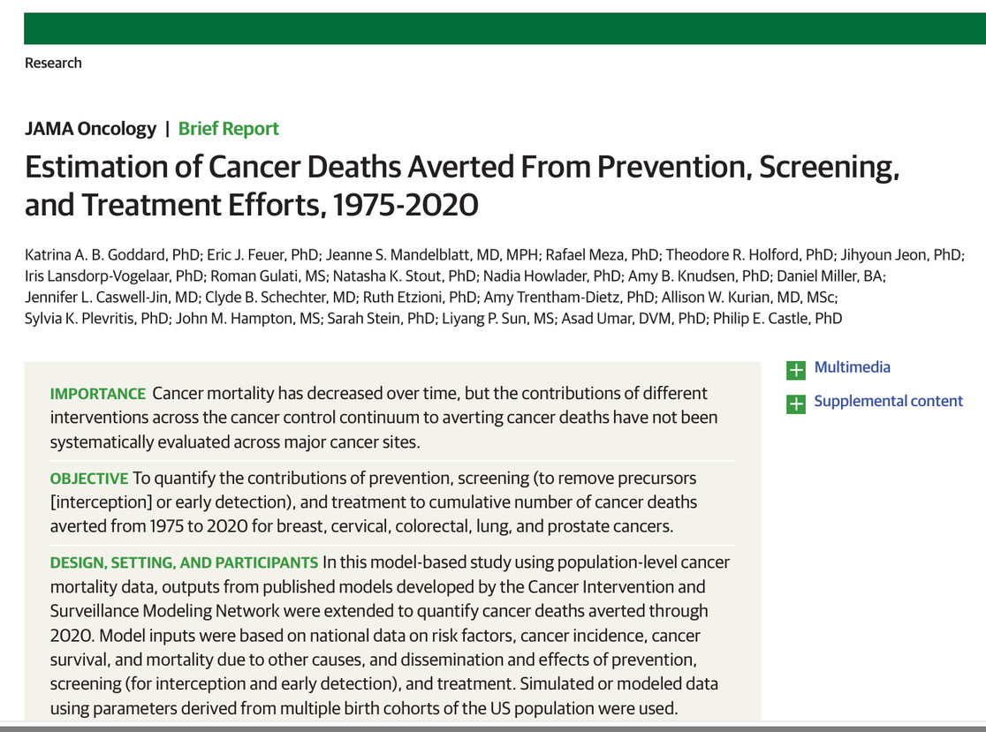
K
a
n
S
u
r
v
i
v
e
Background
2
.
0
The Impact of Cancer Screening
  Modeling study of screening impacts to quantify the contributions of prevention, screening, and treatment to cumulative number of cancer deaths averted from 1975 to 2020 for breast, cervical, colorectal, lung, and prostate cancers.
  360,000 prostate cancer deaths averted
    56% attributable to PSA based screening alone
    The rest due to advances in treatment
Goddard KAB, et al. Estimation of Cancer Deaths Averted From Prevention, Screening, and Treatment Efforts, 1975-2020. JAMA Oncol. 2025;11(2):162-167. doi:10.1001/jamaoncol.2024.5381.
Published online December 5, 2024.

Slide 17

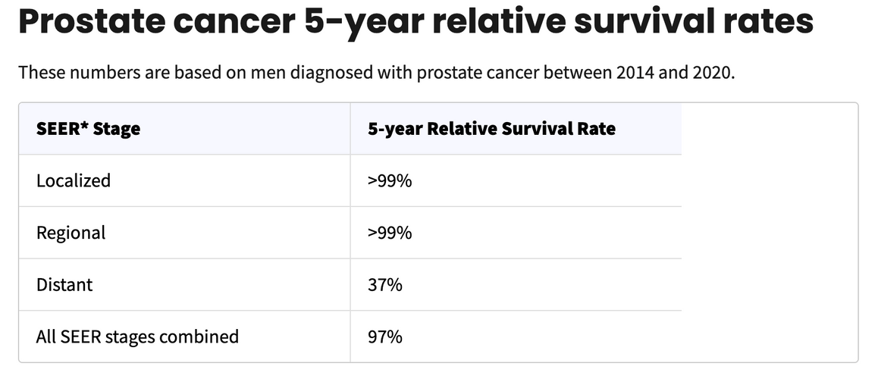
K
a
n
S
u
r
v
i
v
e
Background
2
.
0
Prostate Cancer: Survivorship
  More men die with prostate cancer than because of it.
  Over 3 million men are currently living with PC in the US
American Cancer Society. Cancer Facts & Figures 2025. Atlanta: American Cancer Society; 2025.
SEER Cancer Stat Facts: Prostate Cancer: https://seer.cancer.gov/statfacts/html/prost.html

Slide 18
K
a
n
S
u
r
v
i
v
e
Background
2
.
0
Primary Care & Prostate Cancer
  Most prostate cancer screenings begin in primary care, making PCPs the first line of defense.
  Collaboration with urologists ensures timely diagnosis and treatment.
  In rural areas, limited access to urologists and lower PCP awareness can delay care.
  Strengthening PCP capacity in prostate cancer management is key to improving outcomes.
Forecasting limited access to urology in rural communities: analysis of the American Urological Association census. Cohen AJ, Ndoye M, Fergus KB, et al. https://doi-org.kumc.idm.oclc.org/10.1111/jrh.12376. J Rural Health. 2020;36:300–306. doi: 10.1111/jrh.12376.

Slide 19





K
a
n
S
u
r
v
i
v
e
Screening
2
.
0
USPSTF & NCCN Screening Guidelines
 | Population | Men aged 55 - 69 y | Men 70 y and older
 | Recommendation | The decision to be screened is an individual one | Do not screen
 | Informed Decision Making | Before deciding whether to be screened, men aged 55 to 69 years should have an opportunity to discuss the potential benefits and harms of screening with their clinician and to incorporate their values and preferences in the decision. | Before deciding whether to be screened, men aged 55 to 69 years should have an opportunity to discuss the potential benefits and harms of screening with their clinician and to incorporate their values and preferences in the decision.
 | Risk Assessment | Older age, African American race, and family history of prostate cancer are the most important risk factors for prostate cancer. | Older age, African American race, and family history of prostate cancer are the most important risk factors for prostate cancer.
 | Screening | Screening for prostate cancer begins with a test that measures the amount of prostate-specific antigen (PSA) protein in the blood. Men with a positive PSA test result may undergo a transrectal ultrasound-guided core-needle biopsy of the prostate to diagnose prostate cancer Note: PSA levels can vary and have a risk of false-positive results. | Screening for prostate cancer begins with a test that measures the amount of prostate-specific antigen (PSA) protein in the blood. Men with a positive PSA test result may undergo a transrectal ultrasound-guided core-needle biopsy of the prostate to diagnose prostate cancer Note: PSA levels can vary and have a risk of false-positive results.
National Comprehensive Cancer Network, Prostate Cancer Guidelines Version 2.2025: nccn.org
U.S. Preventive Services Task Force, Prostate Cancer: Screening, 2018 (An update is in progress.) USPSTF

Slide 20




K
a
n
S
u
r
v
i
v
e
Screening
2
.
0
Informed & Shared Decision Making
Patients and providers work together to choose the best screening or treatment option based on medical evidence, patient values, and personal preferences.
Patient goals & preferences
SDM
Clinical evidence & expertise
Biological, psychological, & sociological context
Makarov D, Fagerlin A, Finkelstein J et al. AUA White Paper on Implementation of Shared Decision Making into Urological Practice. American Urological Association 2022. Available at:
https://www.auanet.org/guidelines-and-quality/quality-and-measurement/quality-improvement/clinical-consensus-statement-and-quality-improvement-issue-brief-(ccs-and-qiib)/shared-decision-making

Slide 21

K
a
n
S
u
r
v
i
v
e
Diagnosis
2
.
0
Diagnosing PC May Include...
  Digital rectal exam
  PSA
  Obtain/review biopsies
  Other imaging*
  Somatic and/or germline testing*
  Estimating life expectancy
*as appropriate
National Comprehensive Cancer Network, Prostate Cancer Guidelines Version 2.2025: nccn.org

Slide 22



K
a
n
S
u
r
v
i
v
e
Treatment Options
2
.
0
How We Treat PC
Curative Intent Options
  Radical prostatectomy
  Radiation therapy (EBRT, brachytherapy)
  Active surveillance
  Hormone therapy (ADT)
Advanced/Metastatic Disease Options
  Systemic therapy: chemotherapy, androgen-axis agents (abiraterone, enzalutamide, apalutamide), immunotherapy (sipuleucel-T)
National Comprehensive Cancer Network (NCCN). NCCN Clinical Practice Guidelines in Oncology (NCCN Guidelines®): Prostate Cancer. Version 2.2025. Plymouth Meeting, PA: National Comprehensive Cancer Network; 2025.

Slide 23
K
a
n
S
u
r
v
i
v
e
Treatment: Active Surveillance
2
.
0
Active Surveillance in Localized PC
  PSA screening has increased detection of low-risk prostate cancers
  Aggressive treatments (surgery, radiation) can cause significant side effects
  Goal: Delay or avoid these adverse effects while preserving the option for curative treatment if disease progresses
Recommendation:
  Prostate Specific Antigen (PSA) ~ every 6 months
  Digital rectal exam (DRE) ~ 1/year
  Preferred for patients with very-low-risk PC and life expectancy ≥10 years
National Comprehensive Cancer Network, Prostate Cancer Guidelines Version 2.2025: nccn.org
Briggs RJ, Dunn J, Chambers SK, Jakimowicz S, Green A, Heneka N. The lived experience of active surveillance for prostate cancer: a systematic review and meta-synthesis. J Cancer Surviv. 2025 Feb 12. doi: 10.1007/s11764-025-01748-x. Epub ahead of print. PMID: 39939565.

Slide 24


K
a
n
S
u
r
v
i
v
e
Treatment: Observation
2
.
0
Observation / Watchful Waiting
Recommended for individuals with:
  No symptoms and
  A very-low, low, or intermediate-risk PC + life expectancy ≤5 yrs
  Very-low or low-risk PC + life expectancy 5 -10 yrs
What it means:
  Less intense type of follow-up
  Relies on changes in symptoms
Preferred for individuals with:
  No symptoms and
  Intermediate-risk PC (either favorable or unfavorable) + elife expectancy 5 -10 yrs
May be considered for individuals with:
  No symptoms and
  High-risk or advanced prostate cancer (regional or metastatic) + life expectancy ≤5 yrs
National Comprehensive Cancer Network, Prostate Cancer Guidelines Version 2.2025: nccn.org

Slide 25

K
a
n
S
u
r
v
i
v
e
Surveillance for Recurrence
2
.
0
PSA Monitoring
  Every 6–12 months × 5 years, then annually
  Rising PSA → refer to oncology
Imaging
  Not routine unless symptomatic or PSA rising
National Comprehensive Cancer Network (NCCN). NCCN Clinical Practice Guidelines in Oncology (NCCN Guidelines®): Prostate Cancer. Version 2.2025. Plymouth Meeting, PA: National Comprehensive Cancer Network; 2025.

Slide 26



K
a
n
S
u
r
v
i
v
e
Late & Long-Term Side Effects
2
.
0
Physical
Endocrine & Bone
Genitourinary & Sexual Health
Bone Health
Bowel Issues
Cardiac
Psychosocial
Depression
Fear of Recurrence
Cardiovascular Risk
Metabolic Syndrome

Slide 27
K
a
n
S
u
r
v
i
v
e
Late & Long-Term Side Effects
2
.
0
Prostate Cancer Survivor Priorities
  Recent survey study for PC survivors in Tennessee (n=362)
    ~age of participants, 71 yrs
  Which aspects of PC survivorship care are top priorities?
    70% - fear of cancer spreading / recurring
    45% - changes in sexual health and/or intimate relationships
    30% - changes in urinary health
Orcutt DJ, Chisholm L, Winkler E, Kaufman MR, Barocas DA, Schaffer KR, Johnsen NV. Patient-Centered Priorities in Prostate Cancer Survivorship Care. Urology. 2025 Oct 2:S0090-4295(25)00940-9. doi: 10.1016/j.urology.2025.09.048. Epub ahead of print. PMID: 41046018.

Slide 28
K
a
n
S
u
r
v
i
v
e
Late & Long-Term Side Effects
2
.
0
Genitourinary & Sexual Health
  Erectile dysfunction common after surgery/radiation
  Urinary incontinence
  Penile shortening, Peyronie’s disease
Recommendations:
  Continue open discussion about erectile dysfunction
  Refer for pelvic floor therapy
  Review medications
  Refer for counseling if distress persists
  Screen for depression and anxiety
National Comprehensive Cancer Network (NCCN). NCCN Clinical Practice Guidelines in Oncology (NCCN Guidelines®): Prostate Cancer. Version 2.2025. Plymouth Meeting, PA: National Comprehensive Cancer Network; 2025.
Gerlegiz ENA, Öztürk D, Gürşen C, Akbayrak T, Özgül S. Structured and supervised pelvic floor muscle training following confirmed contraction in post-prostatectomy urinary incontinence: a systematic review of randomized controlled trials. J Cancer Surviv. 2025 Aug 28. doi: 10.1007/s11764-025-01882-6. Epub ahead of print. PMID: 40877548.

Slide 29
K
a
n
S
u
r
v
i
v
e
Late & Long-Term Side Effects
2
.
0
Bowel Issues
  Radiation proctitis
  Urgency, frequency, bleeding
GOAL | RECOMMENDATION
Reduce irritation & improve stool consistency | High-fiber diet (25–35 g/day), hydration, stool softeners if constipated, avoid straining
Symptom control | Topical hydrocortisone, mesalamine, or sucralfate enemas for mild cases (in consultation with gastroenterology)
Manage diarrhea | Loperamide as needed; avoid caffeine, alcohol, and fatty foods
Treat rectal bleeding (minor) | Topical therapies (mesalamine or sucralfate), short courses of steroid suppositories
Pelvic floor therapy | For urgency/incontinence — referral to pelvic floor physical therapy when available
Medication review | Adjust meds that can worsen diarrhea (e.g., metformin, magnesium supplements)
National Comprehensive Cancer Network (NCCN). NCCN Clinical Practice Guidelines in Oncology (NCCN Guidelines®): Prostate Cancer. Version 2.2025. Plymouth Meeting, PA: National Comprehensive Cancer Network; 2025.

Slide 30
K
a
n
S
u
r
v
i
v
e
Late & Long-Term Side Effects
2
.
0
ADT Effects
  Fatigue, metabolic syndrome (weight gain, insulin resistance)
  ↑ Cardiovascular risk
  Osteoporosis, fractures
  Gynecomastia, hot flashes
  Mood/cognitive decline
National Comprehensive Cancer Network (NCCN). NCCN Clinical Practice Guidelines in Oncology (NCCN Guidelines®): Prostate Cancer. Version 2.2025. Plymouth Meeting, PA: National Comprehensive Cancer Network; 2025.

Slide 31
K
a
n
S
u
r
v
i
v
e
Late & Long-Term Side Effects
2
.
0
Psychosocial Effects
  Anxiety, depression, fear of recurrence
  Body image & intimacy concerns
Recommendations:
  Screen for depression and anxiety - normalize mental health support
  Ask about sexual health and intimacy
  Refer if distress persists
National Comprehensive Cancer Network (NCCN). NCCN Clinical Practice Guidelines in Oncology (NCCN Guidelines®): Prostate Cancer. Version 2.2025. Plymouth Meeting, PA: National Comprehensive Cancer Network; 2025.
Citations: NCCN 2025

Slide 32


K
a
n
S
u
r
v
i
v
e
Bone Health
2
.
0
Bone Loss & Screening in PC Survivors
  DEXA if on ADT >12 months
  Calcium/vitamin D
  Bisphosphonate if osteopenia/osteoporosis
Does your practice struggle with getting DEXAs paid for?
National Comprehensive Cancer Network (NCCN). NCCN Clinical Practice Guidelines in Oncology (NCCN Guidelines®): Prostate Cancer. Version 2.2025. Plymouth Meeting, PA: National Comprehensive Cancer Network; 2025.

Slide 33

K
a
n
S
u
r
v
i
v
e
Preventive & Health Maintenance
2
.
0
Keep doing these things!
Cardiovascular
  Lipids, BP HbA1c as indicated
  Counsel on diet, activity, tobacco cessation
Other Screenings
  Age- and risk- appropriate cancer screenings
Immunizations
  Flu, COVID, shingles, pneumococcal
Psychosocial Support
  Depression/Distress screening (PHQ-9, GAD-7)

Slide 34
K
a
n
S
u
r
v
i
v
e
Survivorship Care
2
.
0
Planning & Documentation
  Document diagnosis in Problem List, tx received, current therapy status (e.g., watchful waiting vs. active surveillance)
  Define roles: PCP vs oncology
  Refer to pelvic floor PT, urology, dietitian, behavioral health
  Use EHR tools (prompts for PSA, bone health, CVD risk on ADT)
  Address sexual health (open questions or validated tools)
NCCN Guidelines Version 2.2025. Cancer-Related Fatigue
NCCN Guidelines Version 2.2025. Distress Management

Slide 35
K
a
n
S
u
r
v
i
v
e
Survivorship Care
2
.
0
PC Survivorship Clinic Checklist
Prostate Cancer Survivorship Clinic Checklist
Confirm prostate cancer diagnosis is on the Problem List
Confirm treatment history & current PSA plan (interval, last date)
    PSA every 6–12 mo × 5 yrs, then annually
If ADT Monitor weight, BP, glucose, lipids (metabolic syndrome, ↑ CV risk)
    DXA if on ADT >12 months
    Order Ca + Vit D
    Consider bisphosphonate
Assess urinary leakage, erectile function, bowel changes, hot flashes/sleep
Screen depression (PHQ-9), tobacco/alcohol, activity, weight
Update vaccines per CDC adult schedule
Address USPSTF preventive services (CRC, diabetes, statins, etc.)
Document survivorship care plan in EHR
NCCN Guidelines Version 2.2025. Cancer-Related Fatigue
NCCN Guidelines Version 2.2025. Distress Management

Slide 36
K
a
n
S
u
r
v
i
v
e
2
.
0
Q&A
QUESTIONS?

Slide 37

K
a
n
S
u
r
v
i
v
e
Case Study
2
.
0
Privacy
Please only display or say information that does not identify a patient or that can not be linked to a patient.​
​
Photos used in Case Study slides are freely-usable images and not actual photos of known patients.

Slide 38


K
a
n
S
u
r
v
i
v
e
PC Survivorship Case Study: Jerry’s Story
2
.
0
  Jerry
  Age: 68
  Occupation: Retired high school teacher, part-time cattle rancher
  Marital Status: Married, 3 adult children
  Cancer History: Adenocarcinoma of the prostate, Gleason 3+4=7 (Grade Group 2)
    Diagnosed at age 63, five years ago
    Primary treatment: EBRT x 8 weeks, 6 mo of ADT (leuprolide)
    Current status: NED, PSA stable at 0.4 ng/mL
  Other Relevant History:
    Hypertension
    Type 2 Diabetes Mellitus
    Hyperlipidemia
    Mild depressive symptoms (PHQ-9 = 7)
    History of smoking (quit 15 years ago)
Jerry
Jerry’s Current Medications:
Lisinopril 20 mg daily
Metformin 1000 mg twice daily
Atorvastatin 40 mg nightly
Tadalafil 5 mg PRN (for ED)

Slide 39
PC Survivorship Case Study: Jerry’s Story
K
a
n
S
u
r
v
i
v
e
2
.
0
Jerry’s current concerns...
  Increasing fatigue
  10-pound weight gain since last year
  Mild erectile dysfunction (persistent since treatment)
  Occasional hot flashes
  Reports minimal exercise and “more ranch work from the truck than on foot”
  Denies bone pain, hematuria, or urinary retention
Jerry
What key survivorship considerations come to mind?

Slide 40
PC Survivorship Case Study: Jerry’s Story
K
a
n
S
u
r
v
i
v
e
2
.
0
Key Survivorship Considerations
TREATMENT | POSSIBLE LATE EFFECTS | PCP ROLE
Radiation Therapy | Urinary urgency, rectal irritation, secondary malignancy risk | Assess urinary/bowel symptoms, manage conservatively, refer if persistent
ADT (hormone therapy) | Fatigue, weight gain, metabolic syndrome, osteoporosis, sexual dysfunction | Manage metabolic health, screen for depression, consider DEXA scan, support sexual health
Jerry

Slide 41
PC Survivorship Case Study: Jerry’s Story
K
a
n
S
u
r
v
i
v
e
2
.
0
Key Survivorship Considerations
Metabolic & Cardiovascular Health
  Monitor for metabolic syndrome and osteoporosis
  Reinforce lifestyle modifications (nutrition, physical activity).
  Consider DEXA scan for bone health and supplement with calcium/vitamin D
Sexual & Psychosocial Health
  Continue open discussion about ED; review medications; refer for counseling if distress persists.
  Screen for depression and anxiety—normalize mental health support
Care Coordination
  Communicate with the urologist to confirm surveillance schedule
  Document cancer treatment history and survivorship plan in the EHR problem list
  Encourage participation in exercise and wellness programs (e.g., Silver Sneakers, telehealth PT)
Jerry

Slide 42

PC Survivorship Case Study: Jerry’s Story
K
a
n
S
u
r
v
i
v
e
2
.
0
Practical Workflow Strategies
  Survivorship flag: Add a “Cancer Survivor” banner or tag in EHR.
  Annual Wellness Visit: Use as a structured point for survivorship review.
  Medication Review: Look for lingering ADT-related metabolic effects.
  Patient Education: Provide key follow-up intervals and red flag symptoms.
  Team-based care: Engage nurse / MA to perform screenings (e.g., mood, fall risk, etc.)

Slide 43
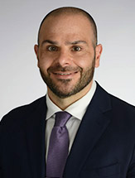
Next ECHO
K
a
n
S
u
r
v
i
v
e
2
.
0
Date: Wednesday, November 5th at Noon
Topic: Lung Cancer Screening & Survivorship
Guest Speaker:
Michal Reid, MD
KUMC Pulmonologist

Slide 44
K
a
n
S
u
r
v
i
v
e
2
.
0
THANK YOU
kansurvive.com

